Slide 1
Kansas Governor’s Council on Tax Reform
TABOR, Social Security, and State Tax Cuts
December 17, 2021
Kim Rueben and Richard C. Auxier

Slide 2
Tax Policy Center Topics
Taxpayer Bill of Rights (TABOR) and other state tax limitations
Taxation of Social Security income in Kansas
2021 review: state tax cuts and ARP spending

Slide 3
TABOR

Slide 4
Tax & Expenditure Limits and Supermajority Rules
More than half of states have a limit on revenues or appropriations (at the state level)
Some states also limit local revenues or specific taxes (e.g., Proposition 13 in California)
These typically apply to appropriations or revenues growth rates (but can be dollar amounts)
More spending limits than revenue limits (but a few states, like Colorado, do both)
14 states require supermajorities to pass a budget or raise taxes
The effect of the rules depends on …
  If they were enacted by the legislature or voters
  If they are statutory or constitutional
  If they require simple legislative majority to override
  If they are set far above or close to current spending and revenue growth rates
In short, binding limits can greatly affect government activity by …
  Shifting level of government in control
  Increasing the cost of issuing debt (for revenue limits)
  Decreasing flexibility in ability to react to changing circumstances

Slide 5
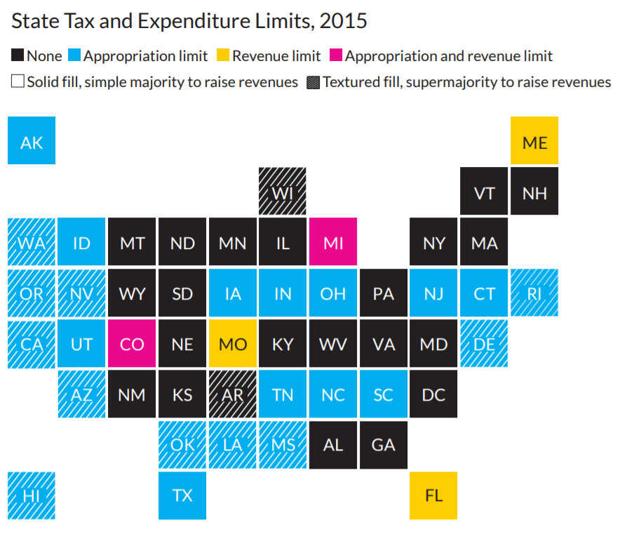
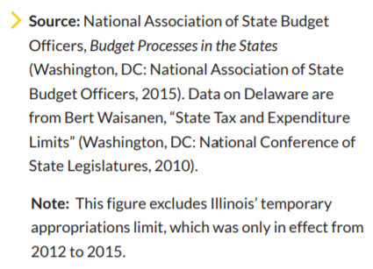
Notes:
Annotated or narrated chart

Slide 6
Details matter – not all limits binding
ME
AK
WI
VT
NH
In 2015:
12 states had just a strict revenue limit in 2015
7 states had just a strict expenditure limit
4 had both
WA
ID
MT
ND
MN
IL
MI
NY
MA
OR
NV
WY
SD
IA
IN
OH
PA
NJ
CT
RI
CA
UT
CO
NE
MO
KY
WV
VA
MD
DE
AZ
NM
KS
AR
TN
NC
SC
DC
OK
LA
MS
AL
GA
HI
TX
FL
Notes:
prior year’s revenue or requires supermajority to pass or raise tax rates (9 in 1990, 17 in 2015)
Defined as binding if required voter approval or supermajority to override.

Slide 7
Colorado’s TABOR Limit
The Taxpayer’s Bill of Rights (TABOR) passed in 1992 is one of the strictest limits
TABOR limits revenue growth at both the state and local level to population growth and inflation (not income growth)
  Requires voter approval for overriding this limitation
Originally limited growth to change from actual revenue
  Would have led to permanent revenue declines after 2001 recession
  Referendum C (2005) suspended TABOR for 5 years then applied limit to prior TABOR cap
Results of TABOR Limit
  Research has found little evidence responsible for Colorado’s growth, and mixed on if lowered overall level of taxes—but TABOR shifted the level of responsibility or distribution across places
  For example, 113 (rural) school districts operate under a 4-day week due to inability to pass voter override.

Slide 8
Taxation of Social Security Income

Slide 9
Federal tax rules for Social Security income
If a household’s “modified AGI” (AGI + tax-exempt interest + half of Social Security income) is less than $25,000 (single) or $32,000 (MFJ) then the filer does not pay tax on any of their Social Security income
  In short, if Social Security is the filer’s only source of income, it is not taxed
If a household earns above that amount then they pay tax on a portion of their Social Security benefits (up to 85% via an income-based formula)
According to a 2015 CBO report:
  About half of all Social Security beneficiaries owed tax on that income in 2014
  Households with AGI less than $40,000: 0.5% of benefits were paid back in tax
  Households with AGI $40,000-$50,000: 2% of benefits were paid back in tax
  Households with AGI $50,000-$100,000: 9% of benefits were paid back in tax
  Households with AGI $100,000 or more: 21% of benefits were paid back in tax

Slide 10
Kansas tax rules for Social Security benefits
If a filer has a federal AGI < $75,000 then they do not pay state tax on benefits
If a filer has a federal AGI > $75,000, and has Social Security income included in their federal taxable income, then that income is also included in the filer’s Kansas taxable income and taxed by the state
  6 states have similar “cliffs” for exempting (and taxing) benefits
  5 states use a credit, deduction, or formula that reduces tax for eligible filers
Possible legislative proposal would exempt Social Security benefits from Kansas tax for all filers, regardless of their AGI
  30 states and DC do not tax Social Security benefits

Slide 11
Who would benefit if Kansas enacted a full exemption for Social Security income?
AGI | Return count | Percentage w/ tax cut | Average tax cut*
$0 to $75,000 | 1,100,000 | 0% | $0
$75,000 to $100,000 | 136,000 | 25% | $1,168
$100,000 to $200,000 | 200,000 | 23% | $1,511
$200,000 to $500,000 | 53,000 | 19% | $1,700
$500,000 to $1,000,000 | 8,000 | 16% | $1,856
$1,000,000 or more | 4,000 | 21% | $2,018
All | 1,502,000 | 6% | $1,412
*“Average tax cut” is only for households getting a tax cut
Tax Policy Center estimates exempting all Social Security from tax in Kansas would cost roughly $130 million annually
All data from the Tax Policy Center’s state tax model using sample weighted to reflect Kansas taxpayers

Slide 12
Alternatives to the full exemption
Increase Kansas’s additional standard deduction for those ages 65 and older
  Kansas ($850) is one of 5 states with an additional standard deduction for seniors
  Increasing the standard deduction would benefit all seniors who take the standard deduction
    This includes many households earning more than $75,000, as about 90% of filers take the federal standard deduction; nationally, itemizers typically earn about $250,000 or more
    This would also benefit households who currently qualify for the Social Security exemption but who have other sources of income (wages or other retirement income) that are taxed in Kansas
Create a retirement tax credit
  Utah offers a retirement tax credit to all filers ages 68 and older
  Credit applies to all sources of income but is phased out based on the filer’s modified AGI
Standard deduction or credit would assist filers who have pension income (Kansas exempts public and military but not private) or other sources of retirement income (e.g., 401-k, IRA)

Slide 13
2021 in Review

Slide 14
What happened to state tax budgets in 2021
Collections in many states returned to or exceeded pre-pandemic levels
  Warning: We cannot say state revenues “returned to normal” because A) we do not have enough data B) revenues in FY 20 and FY 21 were affected by delayed tax filing deadlines, and C) the pandemic is still affecting the economy and tax collections
Revenue recovered faster than expected for three major reasons
  Congressional action: Both direct transfers to states and economic stimulus (checks, UI, CTC, etc.)
  Unequal economic effects: High-earning households worked from home and kept paying state tax
  Consumption shift: Consumers increasingly bought (taxable) goods instead of (non-taxed) services
Budget surpluses are not merely a reflection of broad economic growth, though
  NASBO: State officials stressed that prior budget balancing actions, strong fiscal management, and conservative budgeting helped lead to year-end surpluses
Still, many states used surpluses in calendar year 2021 for tax cuts

Slide 15
“Other” tax cuts enacted in 2021
KS, GA, and UT increased income tax deductions or credits
CA, ID, MD, and ND sent stimulus checks
ID, NC, NE, NH, and OK passed business/corporate income tax cuts
ID and NE passed property tax relief

Slide 16
What are states considering in 2022?
Virginia’s current governor and governor-elect are proposing to end the state’s 1.5% sales tax on grocery food
California is considering expanding its EITC and CTC
New Mexico’s governor proposed cuttings its GRT (which works much like a sales tax)
Iowa is considering “large” tax cuts, possibly a proposal to eliminate its income tax
Mississippi’s governor proposing eliminating income tax (also did so in 2021)
Numerous, politically diverse states are considering tax cuts in 2022—the type and size varies mostly by political control and fiscal situation

Slide 17
What types of tax cuts fit the moment?
Two things to keep in mind:
  The pandemic’s economic effects were very unequal. During the downturn and recovery, high-income households generally did well and low-income households experienced most of the economic pain
  The future of state budgets remains highly uncertain. We know federal assistance is ending and conservative budgeting in 2020 contributed to surpluses. We don’t know how the pandemic will affect state tax revenue growth going forward
What are the ARP restrictions?
  State’s revenue (reported by Census) must be higher than 2019’s inflation adjusted total (plus a 1% “safe harbor”) during years state uses ARP funds
  If state’s reported revenue is below that amount, state must prove offsets or must pay back ARP funds equal to the amount in violation of the rule

Slide 18
How are other states spending ARP funds?
CBPP: 39 states and DC have reported ARP spending
  This spending accounts for 53% of total ARP funds for state governments
  States can allocate ARP funds until Dec. 2024 and spend until Dec. 2026
CBPP finds “replacing lost revenue” is the most common use of ARP funds
  States can spend this on any service; spending must equal reported revenue loss
Earlier AP analysis found refilling unemployment insurance trust funds was most common
  States spent down these funds during the pandemic (which saw unprecedented levels of unemployment); if funds are not refilled, the state must increase taxes on business
Other common uses: human services (cash aid, housing, etc.); economic development (aid to business, workforce training, etc.); and broadband expansion

