Slide 1
Economic Update &
Tax Council Report
Donna K. Ginther
Roy A. Roberts Distinguished Professor of Economics
Director, Institute for Policy & Social Research, University of Kansas
Research Associate, National Bureau of Economic Research
December 17, 2021

Slide 2
Overview
Update on COVID-19 in Kansas and the United States
What’s happened to the US & Kansas economies in 2021.
COVID remains a threat to the full recovery.
Preview of Tax Council Report

Slide 3
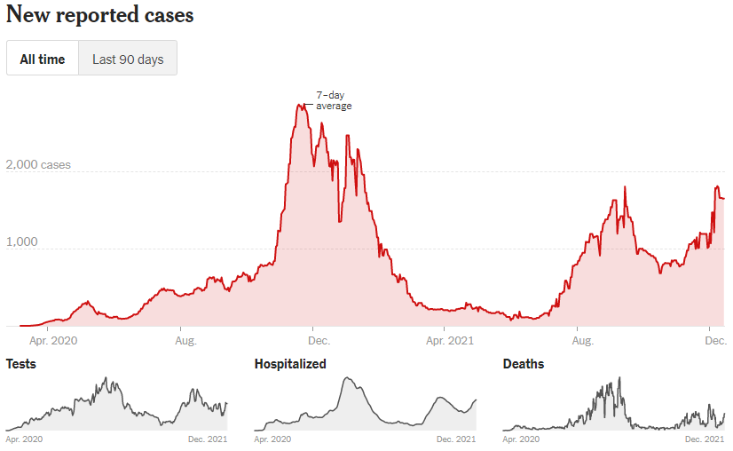
Kansas Daily Cases Are Increasing
The 7-day moving average of new cases is 1,649 per day.
This is an increase of 38% in the past 14 days.
729 were hospitalized on December 14th—an increase of 26%.
COVID is not over.
Kansas cases
Source: New York Times

Slide 4
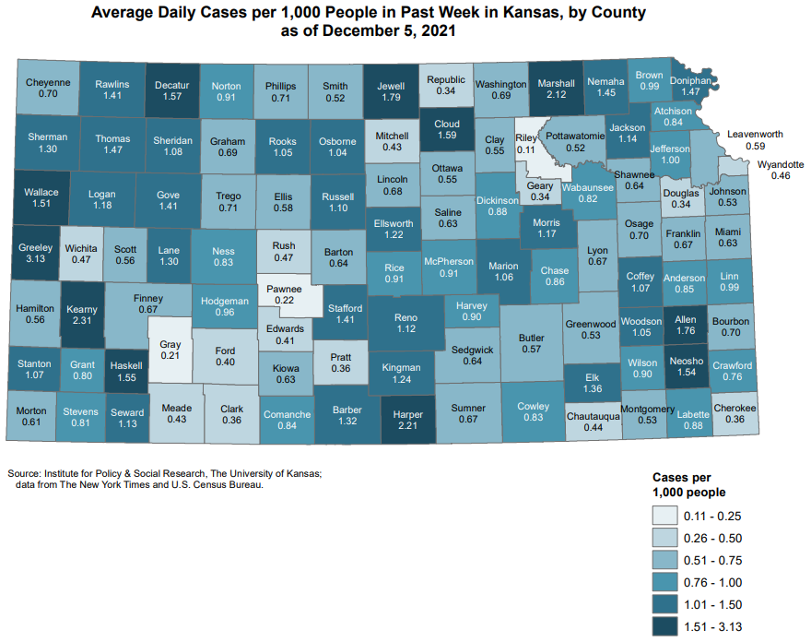
Average Daily Case Rates by County
Darker colors indicate that these counties have higher case rates:
  Ford, Seward, and Finney Counties have case rates that are > .4 per 1,000
  Douglas, Sedgwick & Johnson Counties have case rates of .34 –.64 per 1,000
  Leavenworth & Wyandotte Counties have case rates of .46 – .59 per 1,000
Source: New York Times & US Census Bureau

Slide 5
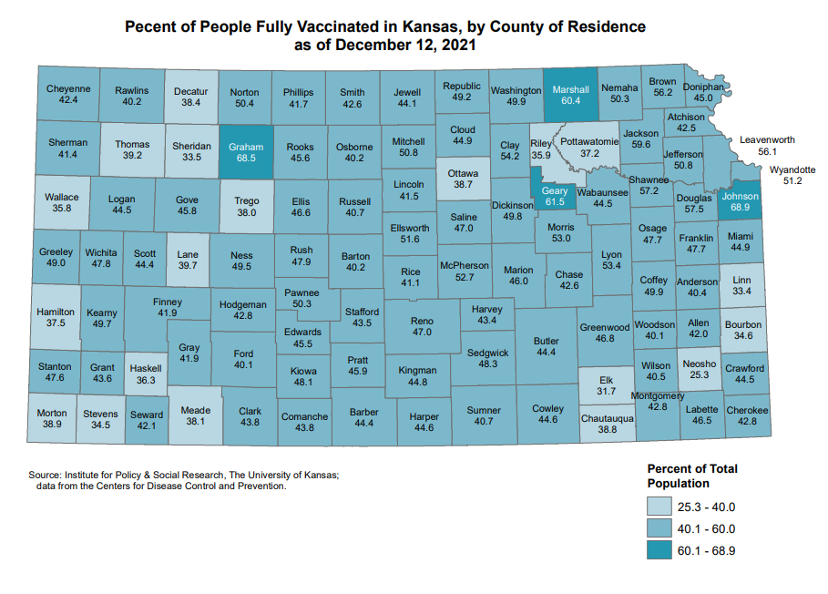
Covid Vaccines per 1,000 People per County
57.9% of Kansas population has received at least one shot.
Darker colors indicate that these counties have more vaccine per population:
  Uneven uptake of the vaccine.
We now have the vaccine for children
Source: KDHE

Slide 6
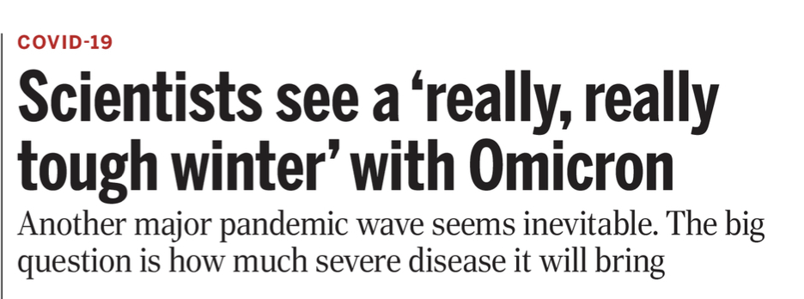
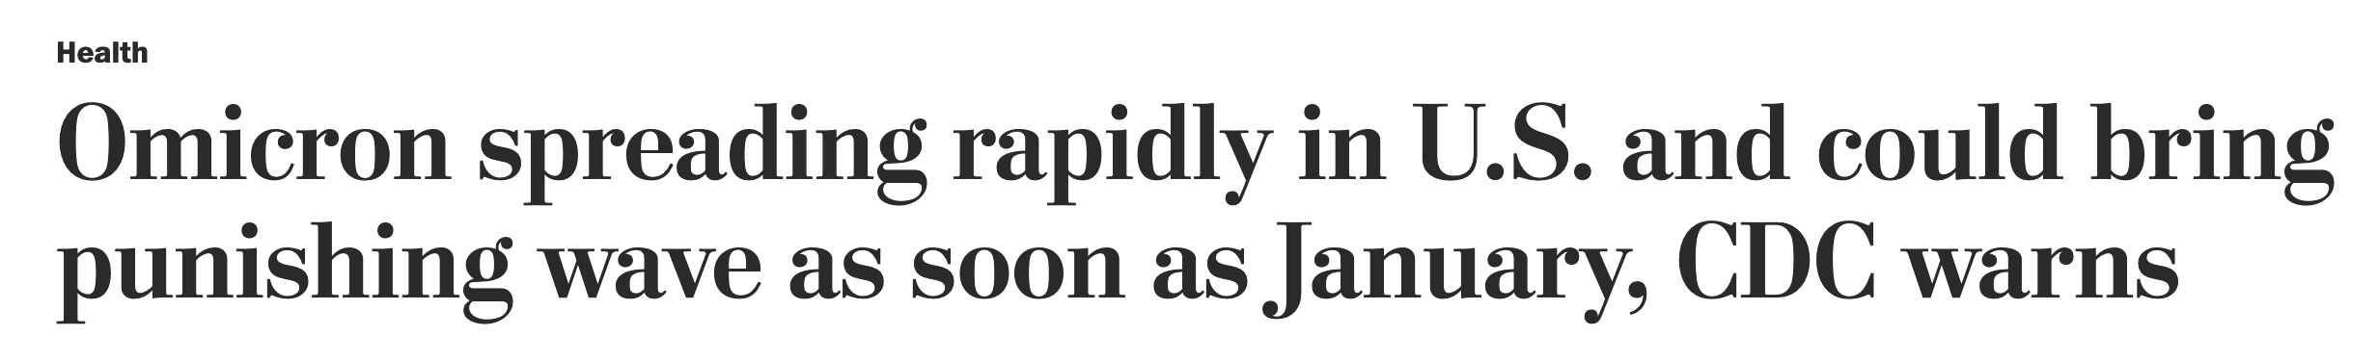
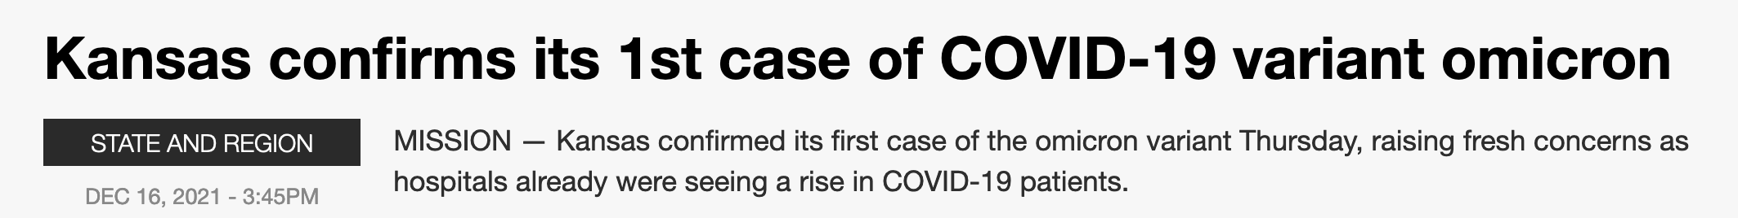
We Are in the Fourth (Tidal) Wave
Omicron is 70 times more contagious than Delta.
UK reporting that Omicron cases are doubling every two days

Slide 7

A Race Between Vaccine Boosters & Omicron
The tough issue here is that, much like staying home or mask-wearing, a significant benefit of getting vaccinated is to protect other people. The more Americans who get vaccinated, the less likely the disease can spread (Daniel Dresner, Washington Post).
Some evidence that the booster protects against Omicron, but it’s unclear whether Omicron will be mild for the unvaccinated.
Health policy is economic policy.
Source: Washington Post

Slide 8
The Recovery Continues
A Strengthening Recovery

Slide 9
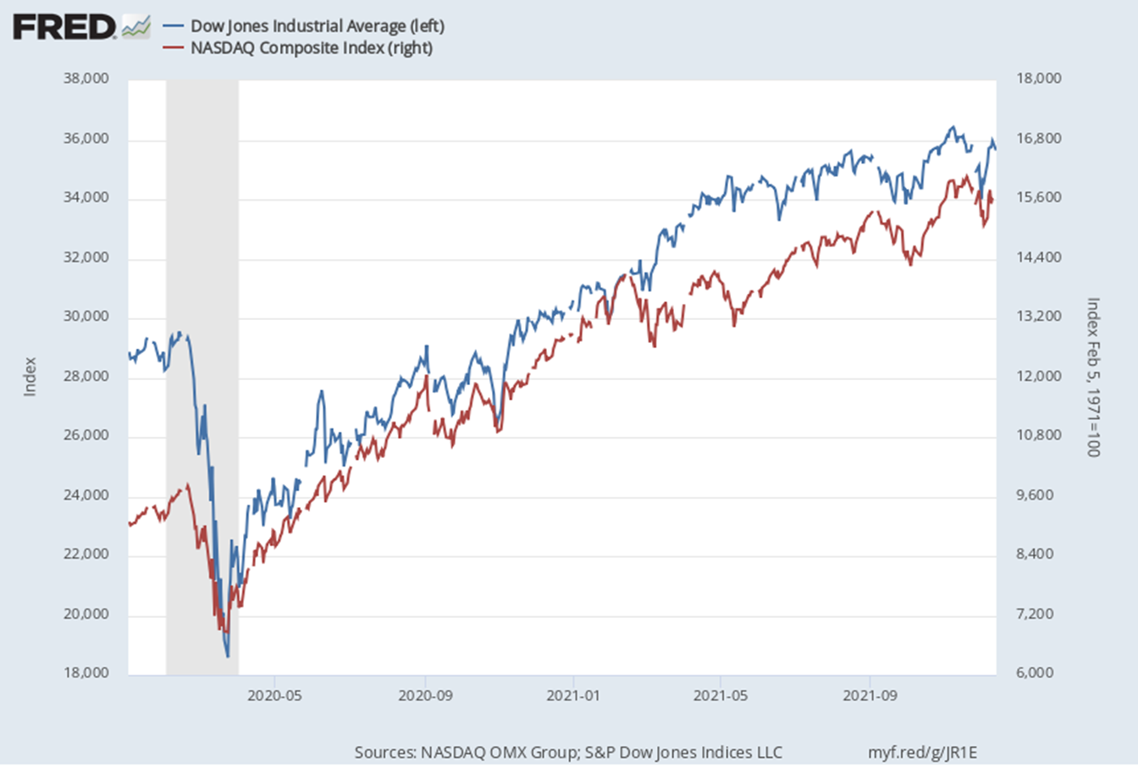
The Stock Market has Soared
Dow Jones Industrial Average is up 17% since January, 2020.
NASDAQ is up 19%.
Retirement portfolios are flush.
9 Donna K. Ginther, PhD
Source: https://fred.stlouisfed.org

Slide 10
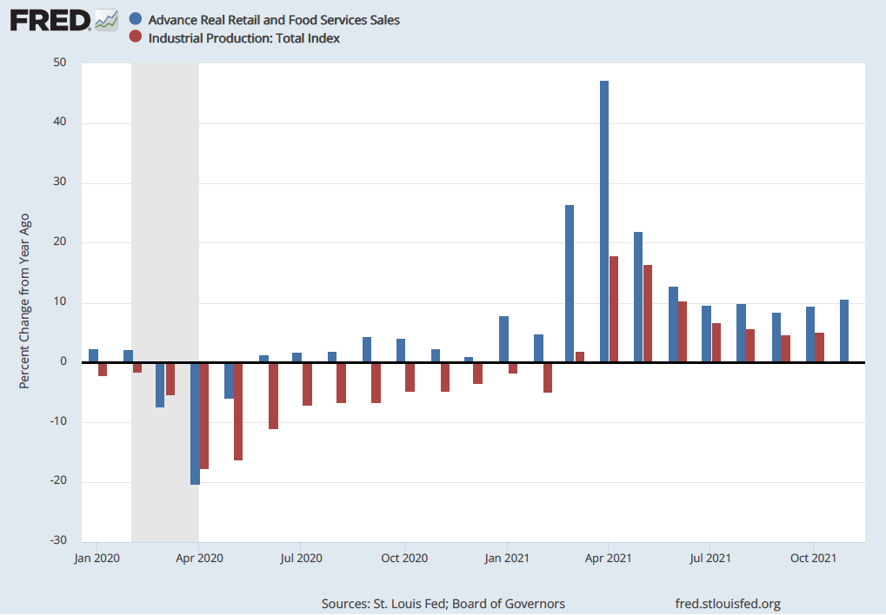
Industrial Production & Retail Sales in November
Compared to a year ago, retail sales were up 10% in November.
Compared to a year ago, industrial production is up 5.1%.
Sales and production have fully recovered.
10 Donna K. Ginther, PhD
Source: https://fred.stlouisfed.org

Slide 11
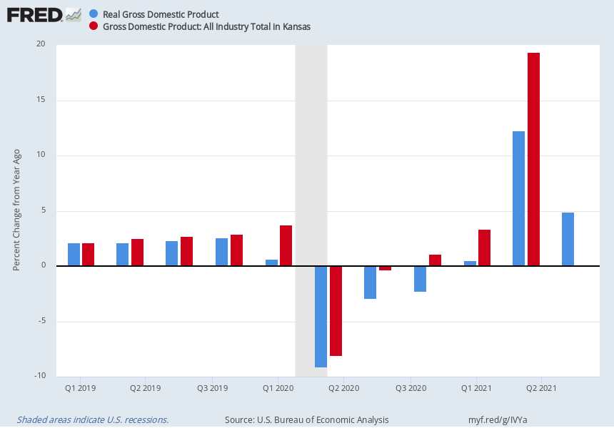
US & Kansas Gross Domestic Product
US Gross Domestic Product was up 4.9% from a year ago in Q3.
Kansas Gross State Product was up 19.4% in Q2 compared to a year ago.
Agriculture income has increased significantly.
11 Donna K. Ginther, PhD
Source: Lewis, FRED, Federal Reserve Bank of St. Louis

Slide 12
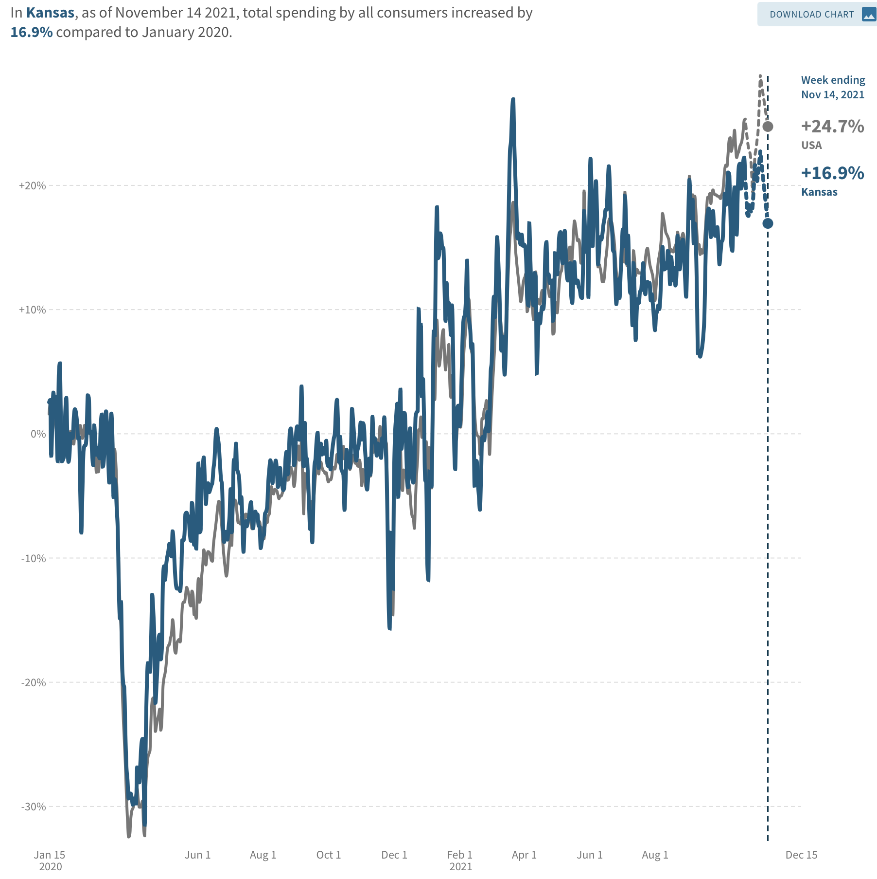
Kansas Consumption is Increasing
Kansas consumption expenditures are up 16.9% compared to January 2020.
US consumption is up 24.7%.
Consumption is 2/3rds of GDP.
12 Donna K. Ginther, PhD
Source: Economic Tracker, https://tracktherecovery.org/

Slide 13
Employment
Roots of the Labor Shortage

Slide 14
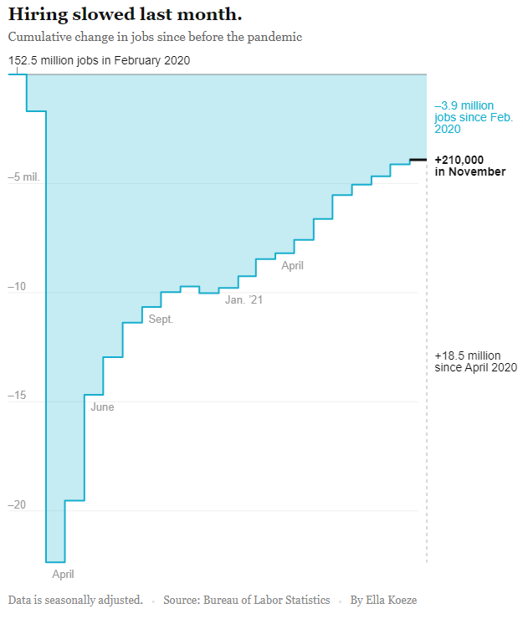
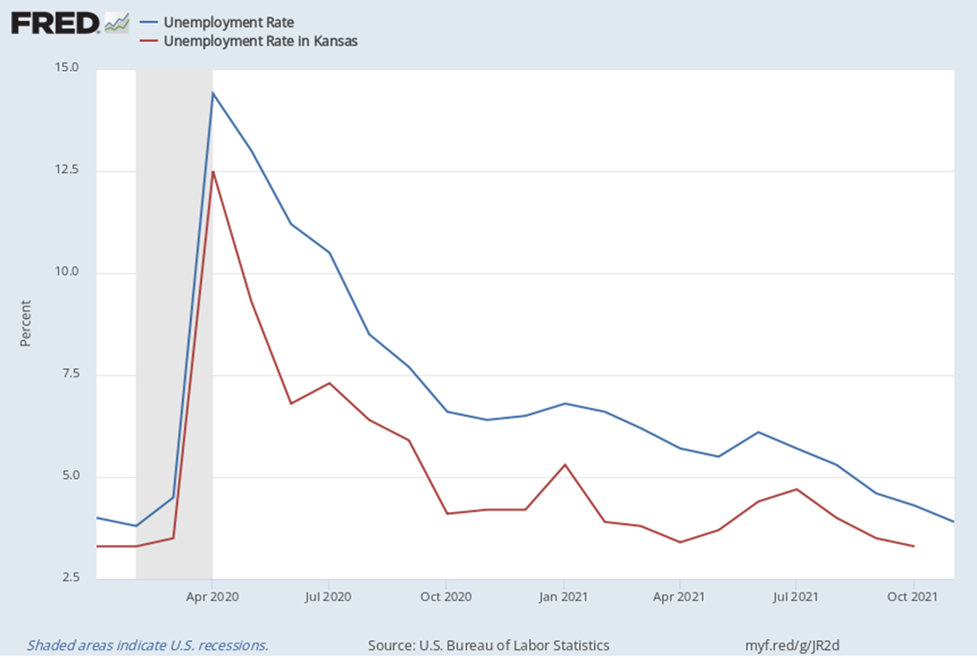
Employment & Unemployment in November 2021
Unemployment decreased to 3.9% in November.
Kansas unemployment rate was 3.6% in November.
Economy added 210,000 new jobs in November. Still down 3.9 million. Gains in leisure and hospitality. Source: NY Times
14 Donna K. Ginther, PhD

Slide 15
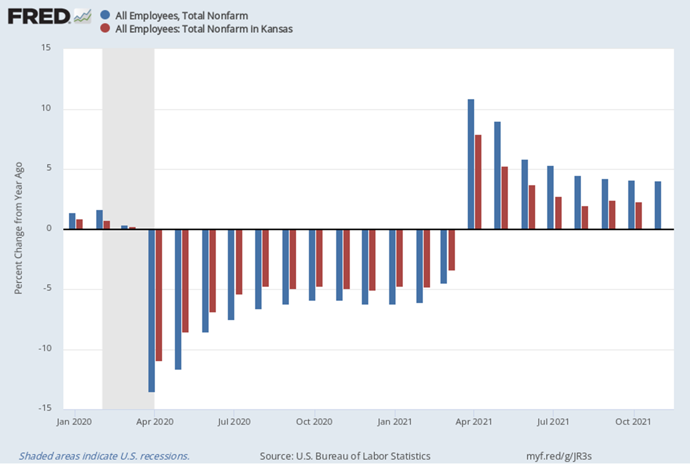
Employment in Kansas and US
Compared to a Year Ago
Kansas employment was increased by 35,000 jobs compared to a year ago.
US employment was up 4% compared to a year ago in November.
More than 300,000 women left the labor force in September.
  Lack of childcare continues to hurt women’s employment.
15 Donna K. Ginther, PhD

Slide 16
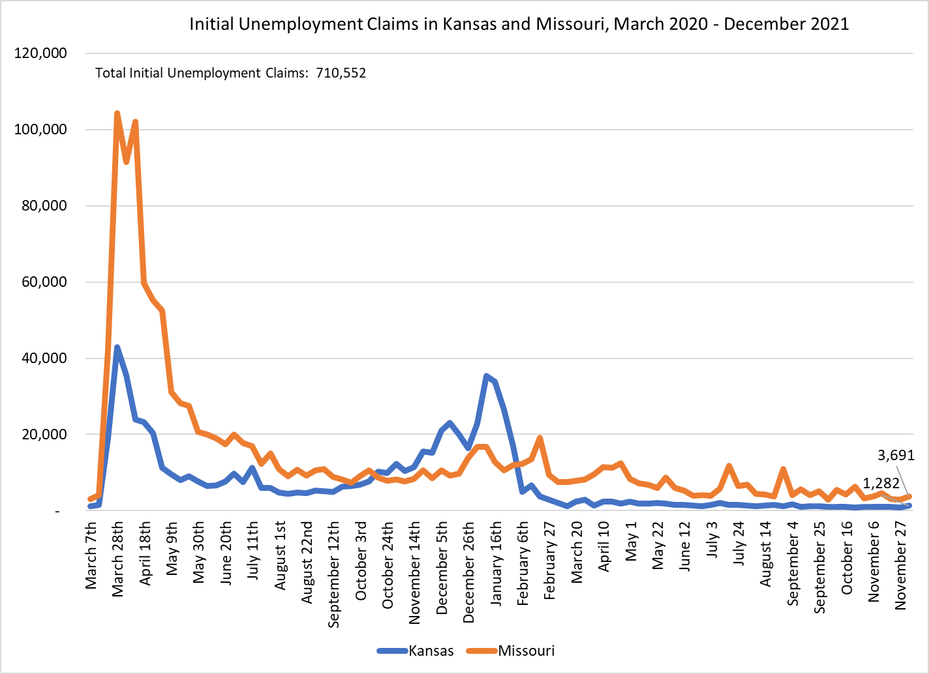
Initial Claims are Trending Down
Kansas continuing and initial unemployment claims have stabilized.
There are 1,282 new initial claims as of the week ending December 4th.
State Unemployment ~3.9%.
16 Donna K. Ginther, PhD

Slide 17
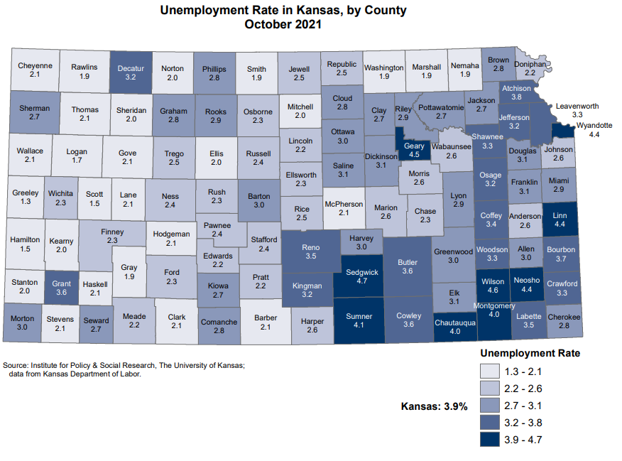
October Kansas Unemployment Rate 3.9%
Uneven impact across the state:
  Sedgwick County 4.7%
  Douglas 3.1%
  Johnson 2.6%
  Wyandotte 4.4%
  Shawnee 3.3%
Unemployment has remained constant since July.
17 Donna K. Ginther, PhD
Source: IPSR calculations using Kansas Department of Labor Data

Slide 18
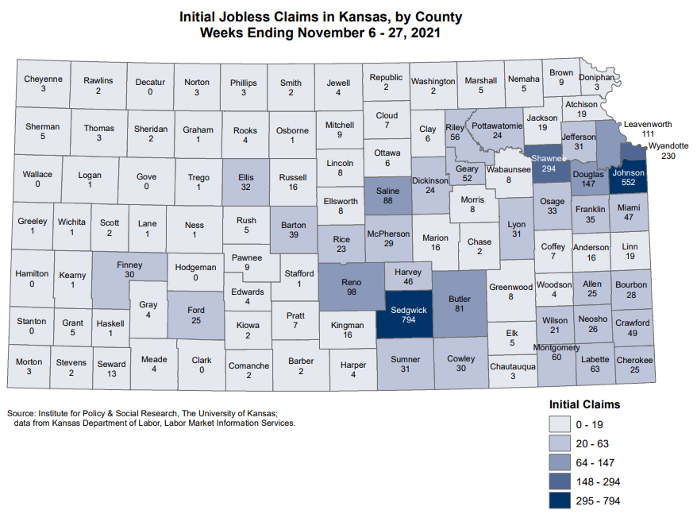
Initial Claims by County
Sedgwick County saw 794 initial claims in November
  Johnson: 552
  Shawnee: 294
  Wyandotte: 230
  Reno: 98
  Douglas: 147
  Leavenworth: 111
Wichita area still sees most new claims

Slide 19
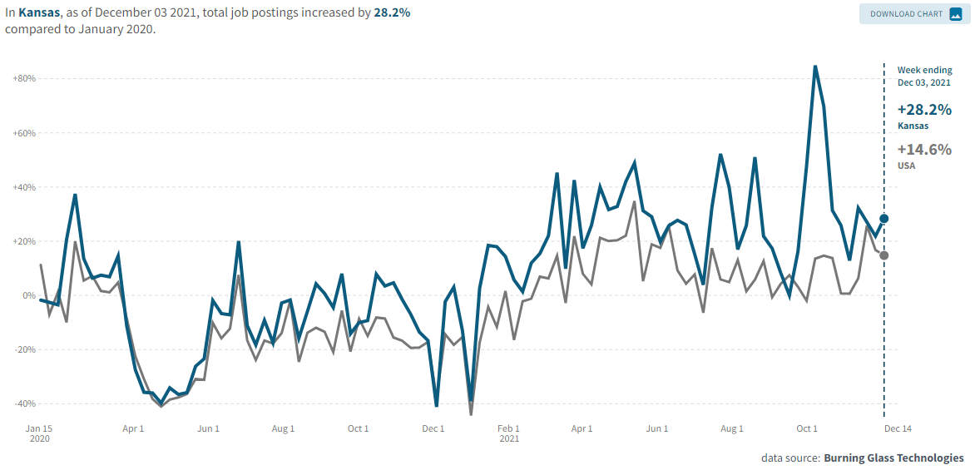
Job Postings Have Increased
Job Postings are up 28% in Kansas compared to the start of the pandemic.
In the US, job postings are up 15%.
Job postings are noisy.
Source: Tracktherecovery.org

Slide 20
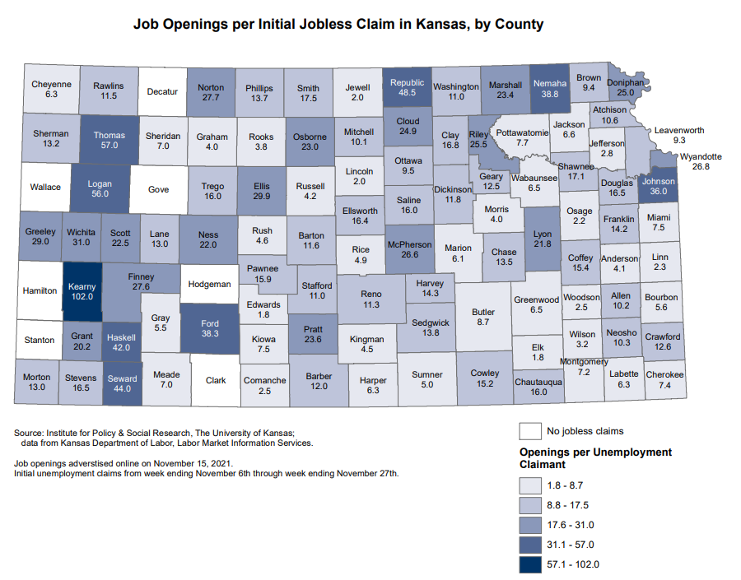
Job Openings Outnumber Unemployment Claims
In all counties with unemployment claims, job Openings outnumber claims.
Six largest Kansas counties have 9.3-36 openings per claim.
Labor shortage is not the result of workers receiving unemployment benefits.

Slide 21
Kansas and US Household Comparison October 11
10% of Kansas households faced loss in employment income
  20% of Kansas households report likely or somewhat likely eviction or foreclosure
Childcare issues are more pressing in Kansas.
Fixing childcare shortage will address the labor shortage
21 Donna K. Ginther, PhD

Slide 22
Inflation is Increasing
Supply Chains are Driving Prices Higher

Slide 23
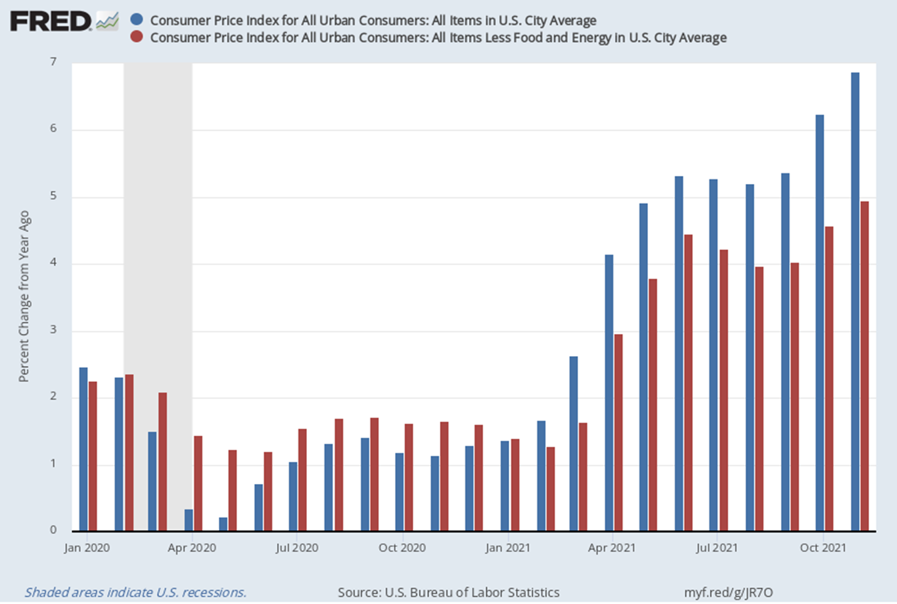
Inflation has Increased
CPI up over 6.8% compared to a year ago.
  CPI less food and energy up 5%.
  Last year inflation was incredibly low due to the pandemic.
Inflation being driven by supply shocks.

Slide 24
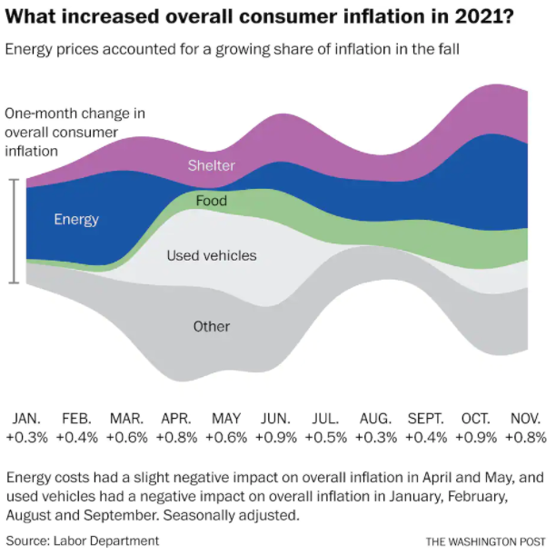
Food and Shelter are Driving Inflation
Increasing cost of energy is now driving inflation.
Food, shelter, and used vehicles are still factors.
Source: The Washington Post

Slide 25
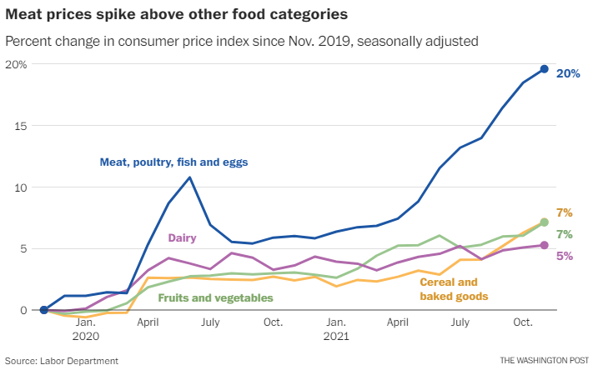
The Price of Meat is Climbing
Meat prices have risen 20% since November 2019.
  Fruits and vegetables up 7%
  Cereals and baked goods: 7%
  Dairy and related: 5%
Agriculture income is up.
Source: The Washington Post

Slide 26
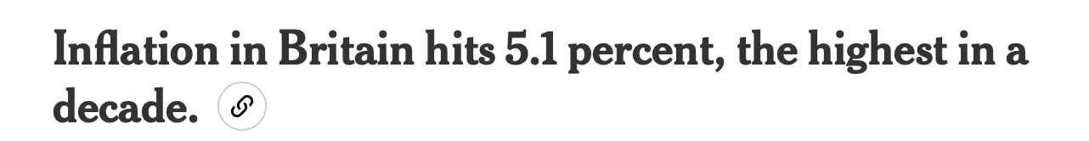
Is Inflation Transitory or Permanent?
Analysing data from a monthly survey of firms to October 2021, researchers Josh De Lyon and Dr Swati Dhingra find that:
  The majority of surveyed firms had increased their volume of business every month since April 2021.
  Firms’ average prices have grown
  Firms in all sectors of the economy report labour shortages.
This is from the UK: https://cep.lse.ac.uk/pubs/download/cepcovid-19-026.pdf
Evidence that inflation is caused by supply shocks to the economy since it is a worldwide phenomenon. It’s not the economic stimulus.
New York Times: 12/15/21

Slide 27
The Recovery is Progressing
Although threats remain

Slide 28
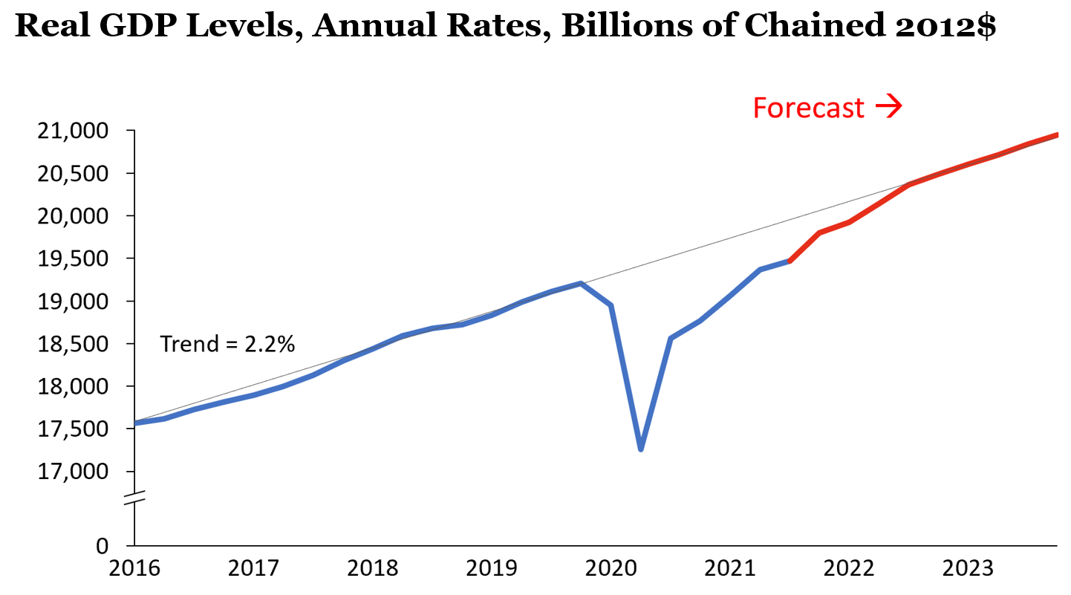
We have surpassed pre-pandemic growth as of Q2 2021
GDP has fully recovered.
There is pent up demand for services that will grow as more people get vaccinated.
By Q3 2023, we will return to trend growth.
Source: US Bureau of Labor Statistics and UCLA Anderson Forecast

Slide 29
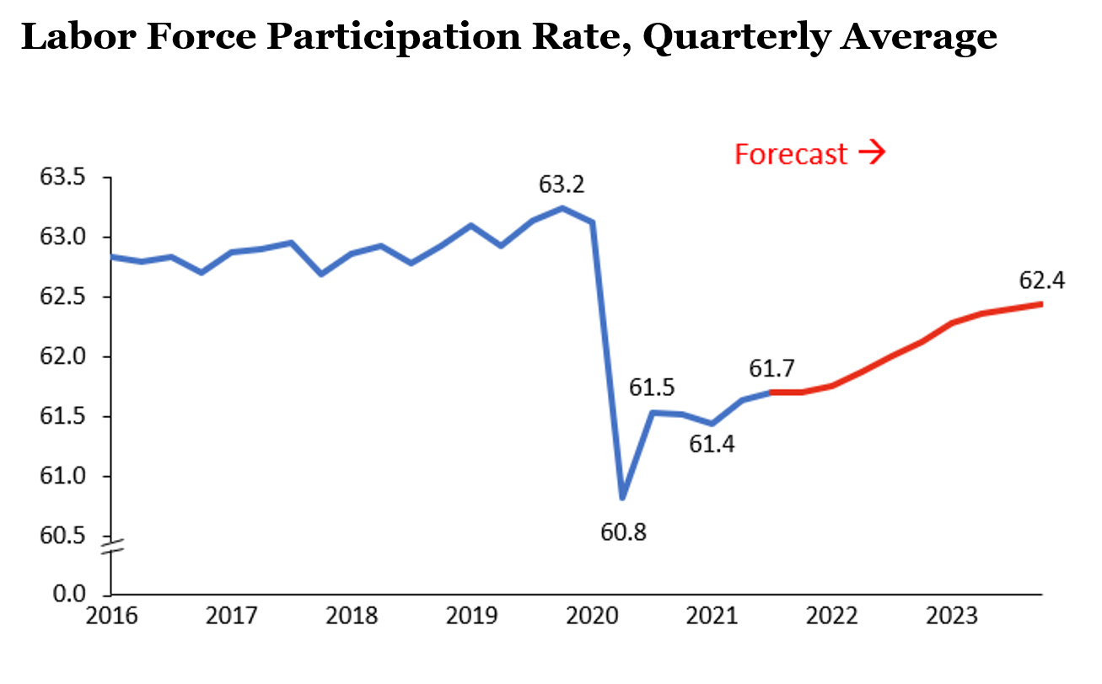
Employment will Take Longer to Recover
According to UCLA Forecast, it will take longer to recover.
Labor force participation is lower due to the “Great Retirement.”
Source: US Bureau of Labor Statistics and UCLA Anderson Forecast

Slide 30
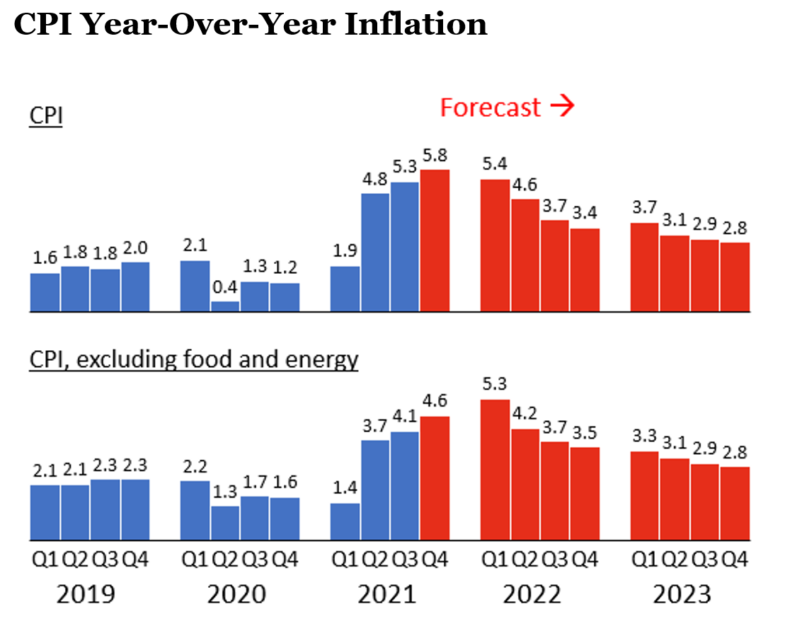
Inflation will Taper Off
According to UCLA Forecast, Inflation will come down as energy prices fall.
Supply will eventually catch up with demand.
Source: US Bureau of Labor Statistics and UCLA Anderson Forecast

Slide 31
Threats to the Recovery
The pandemic is in charge of the recovery.
If COVID gets out of control again, the economy will suffer.
According to UCLA forecast: Closures in other countries due to Omicron will exacerbate supply shocks and fuel inflation. Source: http://www.uclaforecast.com/uploads/forecasts/2021/dec/uclaforecast_dec2021.pdf
Labor shortages will continue to be a drag on growth.

Slide 32
Tax Council Report
Highlights from Our Two Years Together

Slide 33
Goals of the Tax Reform Council
The Governor’s Executive Order tasked this committee with:
Identifying goals, initiatives, performance metrics, and other methods of assessing or achieving increased effectiveness and fairness in the state’s tax system.
Exploring, assessing, recommending and reporting on various tax strategies and policies that may increase the effectiveness and fairness of the state’s tax system.
And then a pandemic hit.

Slide 34

The Three-Legged Stool
Kansas has attempted to balance the tax burden of:
  Income Taxes
  Sales Taxes
  Property Taxes
Our famous three-legged stool

Slide 35
Recently one of these legs is longer than the other
In FY 2019:
Income taxes 26.5%
Sales taxes 28%
Property taxes 34.3% of tax revenues.

Slide 36
Kansas Tax Revenue as a Share of Personal Income
Kansas Tax Revenue as a share of Personal Income is 6.1%
It rebounded in 2019 to be roughly the same rate as it was before the Brownback Tax Cuts
This does not reflect the changes made by SB-50.

Slide 37
Hypothetical Taxpayers

Slide 38
Hypothetical Taxpayers
We will compare taxpayers across income, filing status, and location.
This approach will demonstrate tax incidence and tax fairness for:
  Income
  Sales
  Property & Motor Vehicles
The approach can also be used to “personalize” the repercussions of proposed changes in Kansas taxes.

Slide 39
Hypothetical Taxpayers
We created households of various sizes and martial statuses.
We endowed each household with income.
We located them in places across the state.
  Johnson County
  Salina
  Scott City

Slide 40
Key assumptions about households
All income is wage and salary income
Taxpayers take the standard deduction at the federal and state levels.
All dependents are children under age 18.
The sales-taxable purchases of taxpayers depend on income.
All taxpayers own a home. The value of the home depends on income and location in the state.
The types and ages of vehicles owned by taxpayers depend on income.
We examined three locations: Johnson County (Overland Park), Saline County (Salina), and Scott County (Scott City).

Slide 41
How taxes were calculated
Income Tax
We filled out the federal and Kansas income tax forms for all of the households. We applied federal child credits, federal and state earned income tax credits, and the Kansas food sales tax credit where applicable.
Sales Tax
We used the federal Consumer Expenditure Survey to estimate the ratio of taxable sales to income by income decile. We then multiplied this ratio by the household’s income and applied state and local tax rates.
Residential Property Tax
We used data from the federal American Community Survey to estimate the value of homes owned by families in various income categories and regions of the state We combined this with data on average residential single family home values and tax rates provided by KDOR.
Vehicle Property Tax
We used KDOR’s interactive web site to look up estimated taxes for 2020 for each make, model, and year and county assigned to the hypothetical families.

Slide 42
Sales Taxes
Axe the food tax

Slide 43
In 2019, Kansas was more reliant on Sales Taxes
Compared to competitor states and US averages,
  Kansas relied heavily on sales taxes (38%)
  More on property taxes (31%)
  Much less on income taxes (25%)
  Corporate income taxes make up only 3% and other a much lower 2%
The US on average has higher property

Slide 44
State Sales Tax Per Capita
Kansas has above average state sales taxes per capita compared to the US average and surrounding states.

Slide 45
State Sales Tax Revenue as a Share of Personal Income
Kansas has received a higher share of sales taxes as a percentage of personal income compared to the US and surrounding states.
  This difference became larger starting in 2011

Slide 46
Regressivity of Kansas Sales Taxes
Households with income below $100,000 pay a higher share of their total income in sales taxes than higher income households.
Sales taxes are regressive.

Slide 47
Kansas Local Sales Tax Rates Vary by County
Most counties and municipalities charge extra sales taxes to defray additional property taxes.
In some counties the maximum sales tax rate is greater than 10%.
Johnson County has over 80 different sales taxes depending on location.

Slide 48
Combined State and Local Sales Taxes Paid by Location
Overland Park as the highest sales tax rates.
Total sales taxes paid increase with income.
Statewide average is lower than in these three communities.

Slide 49
Kansas is one of a handful of states that taxes food
12 states besides Kansas tax food.
Only Mississippi taxes food at a higher rate than Kansas.
Six states (including Missouri) that totally or partially exempt food from the state sales tax, allow for local sales taxes on food.

Slide 50
Hypothetical Taxpayer Food Sales Tax Incidence—
4 Person Household
A four-person household earning $25,000 per year spends 29% of its income on food.
A four-person household earning $150,000 spends only 6% of its total income.

Slide 51
Food Taxes and Food Insecurity
O’Connor’s results show that states that reduced the food sales tax experienced a 39% decline in food insecurity.
The Wayfair Decision, coupled with closing the Marketplace Facilitator’s loophole in SB-50, effectively broadened the sales tax base significantly in Kansas.
This provides the opportunity to potentially reduce or eliminate the most regressive tax in the state, the grocery sales tax.

Slide 52
Income Taxes

Slide 53
Income Tax Per Capita
Per capita income taxes increased above national averages between 2005-2012
Brownback Tax Cuts dropped Kansas below US average
Taxes now converging to averages.

Slide 54
Income Tax Revenue as a Share of Personal Income
Kansas had higher income taxes as a share of personal income, starting around 2006
Changed with the Brownback Tax Cuts

Slide 55
Income Taxes Are Progressive
Blue line indicates that low-income households pay a lower share of their income as federal tax.
Kansas income tax is much less progressive.
  It’s essentially a flat tax after low income levels.

Slide 56
Distribution of Individual Income Taxes TY 2020
60.1% of Kansas Tax Returns have $50,000 or less of KAGI
18% of Kansas Tax Returns have over $100,000 KAGI.
Kansas Median Household Income $59,597 in 2019
36.2% (466,655 Households) have KAGI between 0–$25,000
Median KAGI $37,821
Source (Kansas Department of Revenue).
56 Donna K. Ginther, PhD

Slide 57
Federal and State Income Tax Paid by Hypothetical Households
Taxpayers without dependents pay more income tax than those with dependents.
Effective tax rates are higher in the federal system than in the state system.
Senior households pay 1.6% effective tax rate in Kansas at $80,000 of income and an effective tax rate of 3.76% at $100,000 in income.
57 Donna K. Ginther, PhD

Slide 58
Distribution of Corporate Income Taxes TY 2020
32,920 corporations file tax returns in Kansas
62% (20,195) of corporations reported no income.
1,099 corporations paid almost 91% of corporate taxes.
Only 1,619 corporations earn $500,000 or more
Total Corporate Tax Liability is $689 Million
58 Donna K. Ginther, PhD

Slide 59
Senate Bill 50
Closed the Marketplace Facilitator’s loophole
  Fiscal note close to $100 million in additional revenue
Eliminated Global Intangible Low-Taxed Income (GILTI) is taxed on the federal level.
  Benefitted large multinational corporations.
  Fiscal note -$24.2 million
De-coupled from IRS to allow itemization and increased standard deduction by $500.
  Benefitted high-income households.

Slide 60
Who Benefits from Itemization?
SB-50 Itemizers are difference between those who Itemized in 2017 and Itemized in 2019.
Median Taxpayer is $21,442 KAGI
  1% of filers below the median will benefit from itemization.
Percentages are estimates of those within KAGI bracket who will be new SB-50 itemizers.
  Benefits flow to the top 18% of taxpayers
6.6% more taxpayers will benefit from itemization in SB-22.
60 Donna K. Ginther, PhD

Slide 61
Who Benefits from Itemization?
Governor’s proposed increase in the standard deduction by 35%
  Tax savings ranges between $101 to $150 per year for our hypothetical taxpayers.
Taxpayers would need $10,750 in deductions to break-even with the Governor’s plan.
  More deductions mean higher tax reductions.
But only 6.6% of mostly higher income taxpayers would benefit.
Increase in standard deduction benefits all taxpayers.
61 Donna K. Ginther, PhD

Slide 62
Property Taxes

Slide 63
Property Taxes
Property Taxes are set locally
  Focus on Housing Taxes
Housing valuations are adjusted every year.
  Property owners can appeal these valuation adjustments.
Valuation increases do not necessarily translate into property tax increases
  Except for the 21.5 mills of fixed state property tax levies.

Slide 64
Property Taxes
When a local unit adopts a no-growth budget and all valuations in that taxing jurisdiction have gone up by the same percentage, mill levies would automatically adjust downward to provide the same level of property tax dollars.
  Local governments adopt budgets in terms of dollars and do not automatically collect a revenue windfalls from valuation increases.
  Nevertheless, changes in valuations create consternation.
    But we have a user-friendly valuation appeals system.

Slide 65
Home Values, Mill Levies, and Property Taxes by Location
Johnson County has lower Mill Levies, but higher overall tax because of higher valuations.
Scott County Mill Levies are almost double those in Johnson County.

Slide 66
Home Values, Mill Levies, and Property Taxes by Location
Property Taxes increase with income level because of owning a higher valued house.
Statewide average rates are higher than in Saline and Scott Counties
Housing prices (and as a result, valuations) are increasing.

Slide 67
Residential Property Tax as a Percentage of Income for a Family of Four
Low Income households are excluded because they do not own a home.
Property taxes in Kansas are regressive:
  Lower income households pay a higher share of income in property taxes.

Slide 68
Housing Prices are Rising This Year
Data from the Federal Housing Finance Agency, change in housing price index.
These are percentage changes in prices for purchased homes.
Housing price increases will increase housing valuations for property tax purposes.
Location | Price Increase %
United States | 18.5%
Kansas | 14.7%
Kansas City MSA | 15.6%
Wichita | 13.9%
Topeka | 15.8%
Lawrence | 16.2%

Slide 69
Property Tax Subcommittee Recommendations
Expanding the $20,000 residential exemption to $40,000
Expansion of the Homestead Property Tax Refund eligibility
Restoration of the LAVTRF funding

Slide 70
Parting Thoughts
Kansas taxes are regressive because of our over-reliance on the sales tax.
  Axing the food tax will reduce some of that regressivity
  Local sales taxes were put in place because of high property taxes.
SB-50 benefitted larger corporations and higher income taxpayers.
  Generated more inequity in the tax code.

Slide 71
Parting Thoughts
Brownback tax cuts did not lead to economic growth.
  Instead, state disinvested creating challenges with:
    Antiquated unemployment insurance system
    Underinvestment in broadband
  While these investments were postponed, the state still needs to do this work.
CARES, ARPA, Infrastructure means more money coming to the state
  Let’s address our crumbling infrastructure.

Slide 72
Parting Thoughts
COVID is not over. Goldman Sachs cut their forecast because of Omicron.
  Health policy is good economic policy.
  Or as UCLA indicated, the pandemic owns the recovery.

Slide 73

Thank You!
Danke

