Slide 1
An update on how COVID-19 is affecting state budgets
Prepared for the Governor’s Council on Tax Reform
November 2020
Richard Auxier

Slide 2
Overview of slides
Why the current economic downturn varies significantly across states
How revenue has changed since March and what to expect going forward
What states are doing in response

Slide 3
The COVID-19 recession is unprecedented
But the severity of the economic downturn varies significantly across states

Slide 4
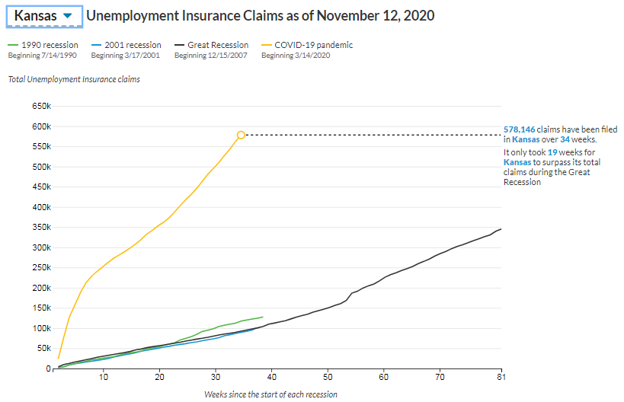
Unemployment insurance claims are still climbing

Slide 5
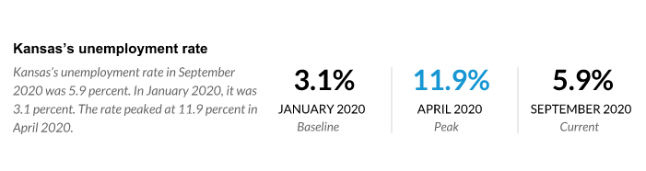
The unemployment rate is improving but still high

Slide 6
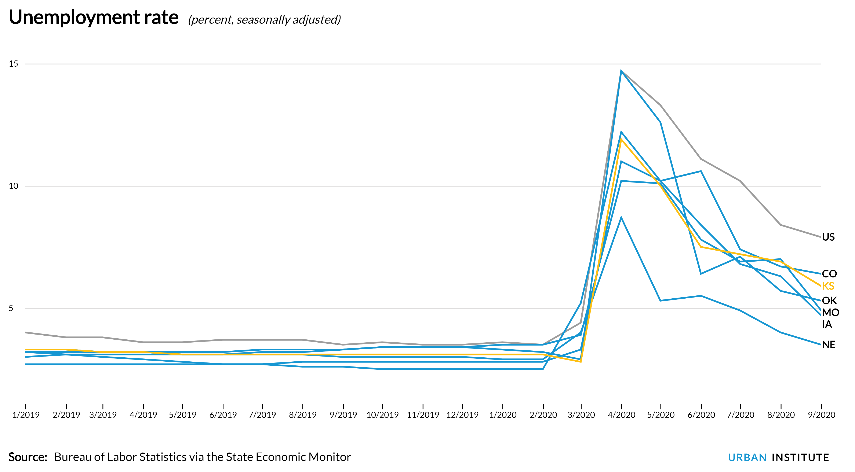
Kansas’s rate is higher than neighbors, lower than US

Slide 7
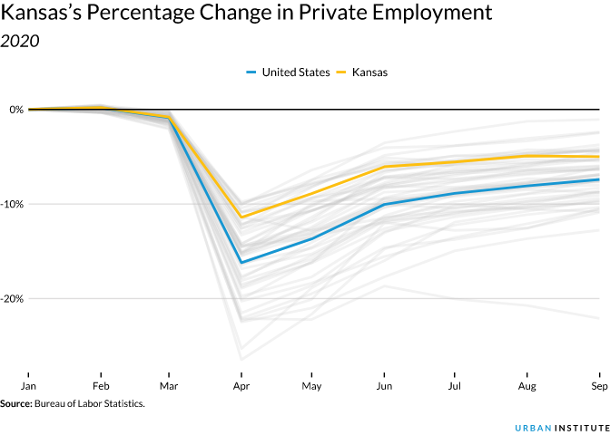
Kansas’s private job losses are not as bad as most other states
KS: -5.0%
CO: -4.9%
IA: -5.9%
MO: -5.3%
NE: -3.7%
OK: -5.5%
In each state (except OK*) leisure and hospitality saw largest drop in both percentage and total jobs
*mining (includes oil) was largest percentage drop

Slide 8
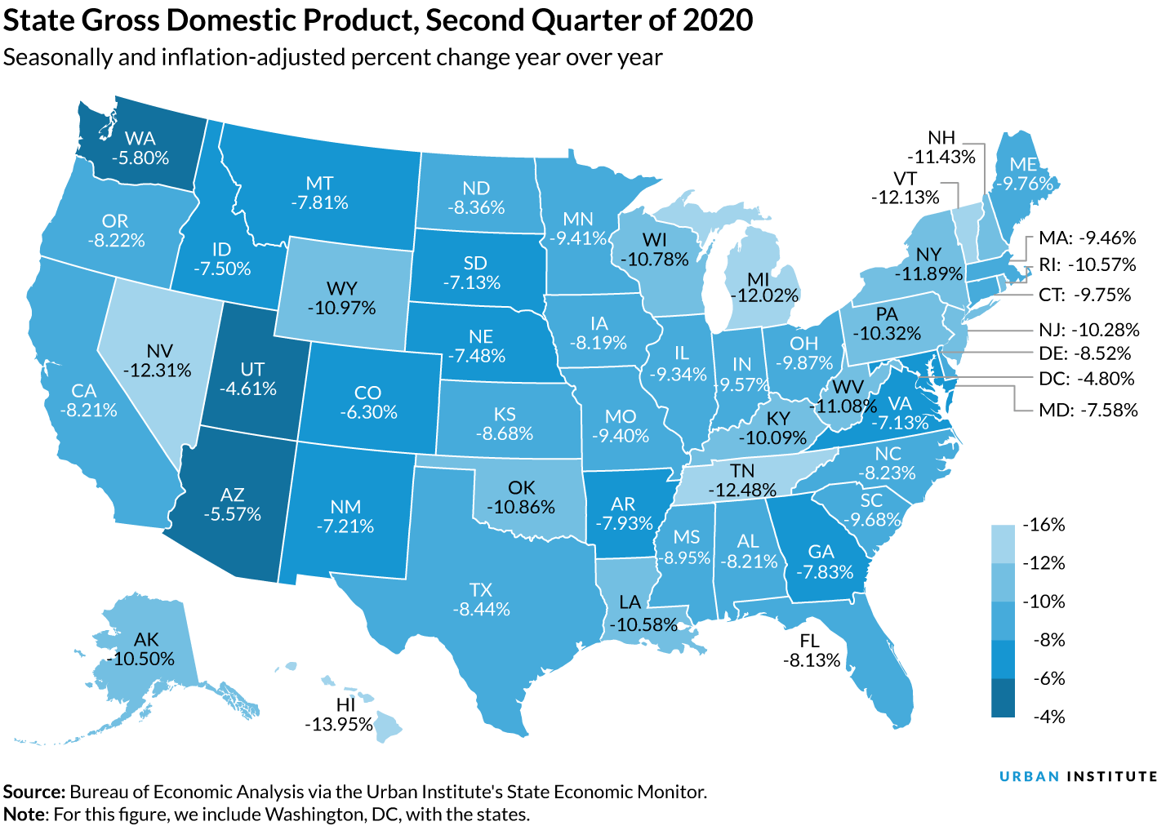
Kansas’s second quarter GDP decline was close to nation’s
GDP decline was driven in large part by collapse of accommodation and food service sector; states more dependent on this sector (HI, NY) saw bigger drops.
States with large energy sectors (OK) were also harmed more than other states.

Slide 9
States revenues changes also vary across states
Going forward, there is a case for optimism but a bigger argument for caution

Slide 10
Changes in tax revenue varies significantly across states
Kansas’s total state tax revenues collected between March 2020 and August 2020 were 5.7% lower than over the same period in 2019
  State tax revenue changes since March range from a 31.0% decline in Alaska to a 10.2% increase in Idaho
  Colorado +0.3%; Iowa -3.7%; Missouri -5.7%; Nebraska +0.9%; Oklahoma -6.6%
A state’s tax revenue might be up, down, or steady depending on the prevalence of the coronavirus, the state’s major economic sectors, and its revenue system

Slide 11
What have we learned so far?
Income tax revenue declines were not as bad as predicted
  The most negatively affected workers were low-income workers; these workers do not always withhold tax from paychecks and often do not owe state income tax
Sales tax revenue was depressed in states hard hit by the economic downturn, specifically in states that rely heavily on accommodation and service industries
  California, Florida, Hawaii, Maryland, and New York
  One thing not hurt: groceries
Oil-dependent states were also hurt more than others because declines in air and car travel affected oil production and sales
  Alaska, Louisiana, New Mexico, North Dakota, and Oklahoma

Slide 12
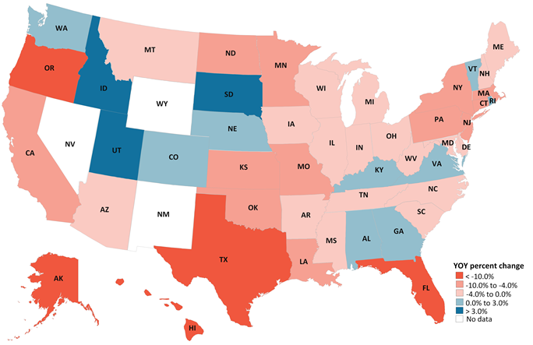
Percent change in state tax revenues: March-September 2020 vs. March-September 2019

Slide 13
The future: some optimism but a lot of uncertainty
The Kansas Division of Budget recently published a revised revenue estimate that is far more optimistic than its April forecast
  Kansas revenue will increase in FY 2021 relative to FY 2020, but revenue will decrease in FY 2022 relative to FY 2021
Similarly, recent forecasts are more optimistic than spring forecasts in California, Colorado, Maryland, Pennsylvania, and Virginia
But many states still project revenue declines (sometimes in the double-digits) for FY 2022 and revenue problems beyond that

Slide 14
The case for caution
We do not know how the pandemic will spread and economy will change in the winter months ... but we do know that that COVID counts are currently at record highs across the country and economic restrictions are returning
We do not know if Congress will provide further fiscal aid for state and local governments ... but we do know that the direct fiscal aid has been spent and the economic provisions that propped up budgets are expiring at the end of the year
We also know that Congress’s failure to pass further assistance a decade ago prolonged the Great Recession and particularly the ability of state and local governments to recover

Slide 15
How are states responding?

Slide 16
Budget cuts and rainy day funds
Most states were forced to cut their FY 2020 budgets, sometimes eliminating $1 billion or more in spending (Colorado, Florida, Georgia, Tennessee)
  Reminder: state and local budget cuts are often job losses
  US has lost 1.2 million state & local government jobs since January, or 6%
Many states are also planning for additional budget cuts in FY 2021
  Much of this is still TBD with 2021 legislative sessions approaching
In addition to its economic mix and revenue trends, how much a state cuts now depends in part on its savings—both how much it has saved and how much it is willing to draw down now vs. in the future

Slide 17
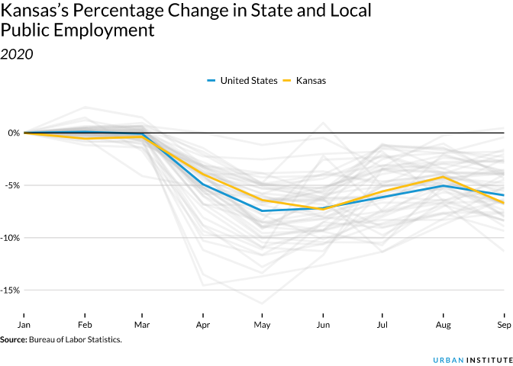
Kansas’s state & local job losses are close to the US average
KS: -6.7%
CO: -9.4%
IA: -3.5%
MO: -0.4%
NE: -3.9%
OK: -3.9%

Slide 18
Relatively few major state tax changes so far
New Jersey increased its income tax rate taxable income greater than $1 million
California made changes to its treatment of NOLs
Some states decoupled from provisions in the CARES act
  This prevented revenue losses but did not increase revenue
Colorado, New Mexico, and other states are considering reforming their state income tax expenditures
In contrast, Nebraska passed a large property tax cut and New Hampshire is considering business tax cuts during its next legislative session

Slide 19
State ballot measures on taxes had mixed results in 2020
Arizona passed a large income tax hike on high earners (for education spending)
Arkansas approved a higher sales tax rate (for transportation spending)
Tobacco tax hikes passed in Colorado and Oregon
Gambling was expanded in several states (including in Nebraska)
Illinois rejected a progressive income tax system (currently has a flat tax rate)
California rejected a tax increase on commercial properties
Colorado passed an income tax rate cut and passed a new payroll tax (for PFL)
But the big winner was marijuana ...

Slide 20
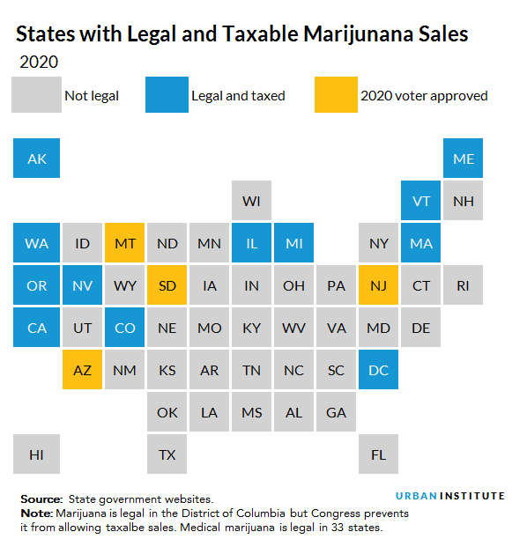
There was one distinct tax winner at the ballot box ...

Slide 21
Thank you
Contact information
  Richard Auxier: rauxier@urban.org
  Kim Rueben: krueben@urban.org
  Lucy Dadayan: ldadayan@urban.org
Resources online
  https://www.taxpolicycenter.org/
  https://www.urban.org/policy-centers/cross-center-initiatives/state-and-local-finance-initiative
  https://www.urban.org/policy-centers/cross-center-initiatives/state-and-local-finance-initiative/projects/state-fiscal-pages-covid-edition (NEW 50-STATE COVID DATA RESOURCE)

