Slide 1
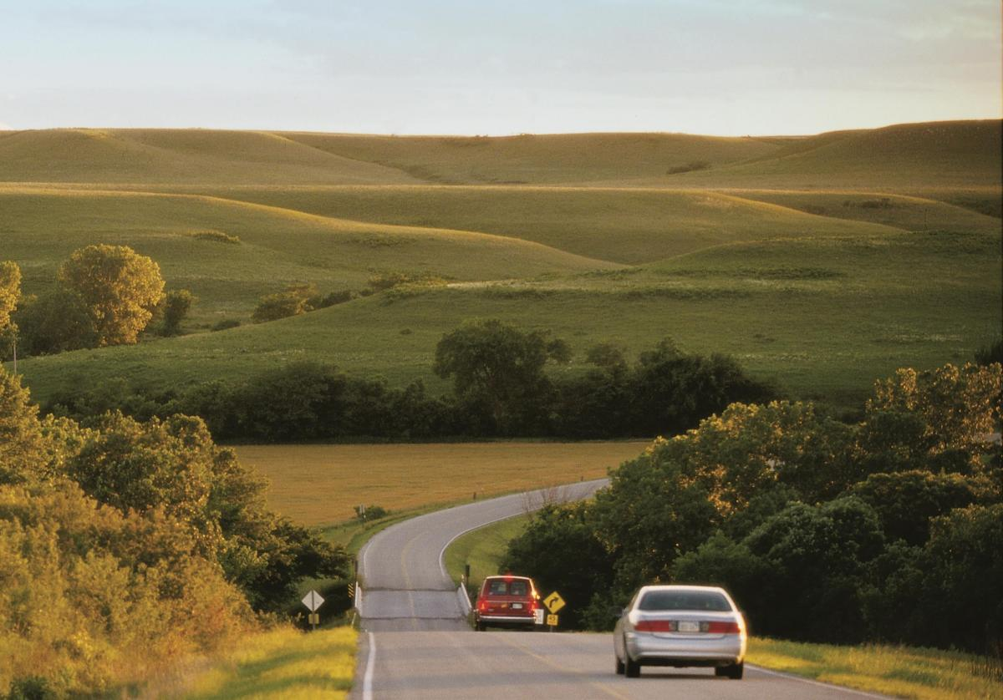

Governor’s Council on Tax Reform
September 24, 2019

Slide 2
How Does Kansas Fund Transportation?
Federal Funds
Motor Fuels Tax
Registration, License, Permit, and Other Fees
Bond Proceeds
Local Funding
Sales Tax
Special City and County Highway Fund
(SCCHF)
State Highway Fund (SHF)
Transfers to other State agencies
Protected Revenue
Unprotected Revenue

Slide 3



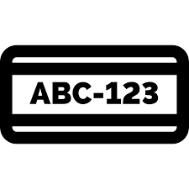
State tax revenues
MOTOR FUEL
REGISTRATION & LICENSE
SALES*
Avg. Annual Revenue (generated) | $530 M | $300 M ($150 M goes to SCCHF) | $200 M
Current Rate (s) | 16% of total state sales tax received | Gas - 24 cents Diesel- 26 cents | Passenger vehicles -$30 -$40 Large trucks -$40 -$2,070
Current Rate Established | FY 2014** | FY 2003 | Passenger vehicles – FY 2003 Large trucks – FY 2014
*Unprotected revenue
** Dedicated for transportation in 2014, there have been multiple revenue-neutral adjustments to the rate

Slide 4
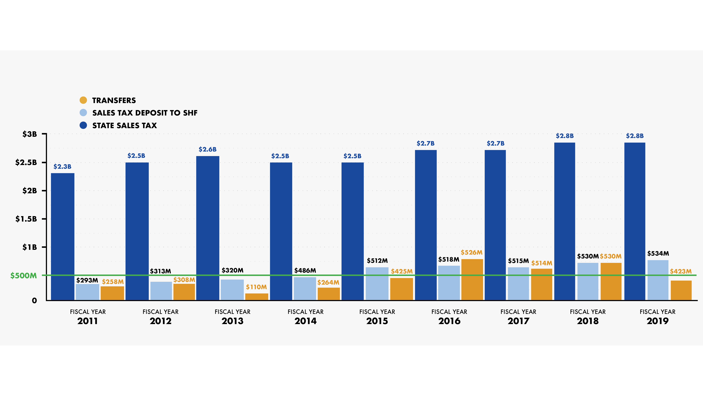
Sales tax revenue has been steady, but transfers grew
Notes:
Note: In FY 2016, transfers exceed sales tax deposited. This is due to a $4 registration surcharge fee that is not protected. The fee was originally adopted to improve the computer system of the Dept. of Revenue. And once the system was improved, that money (about $12 M annually), was supposed to go to the State Highway Fund as part of T-WORKS. In 2016, the legislature took a portion of that money too. Since it’s a surcharge and separate from the actual registration fee – it’s not protected.

Slide 5
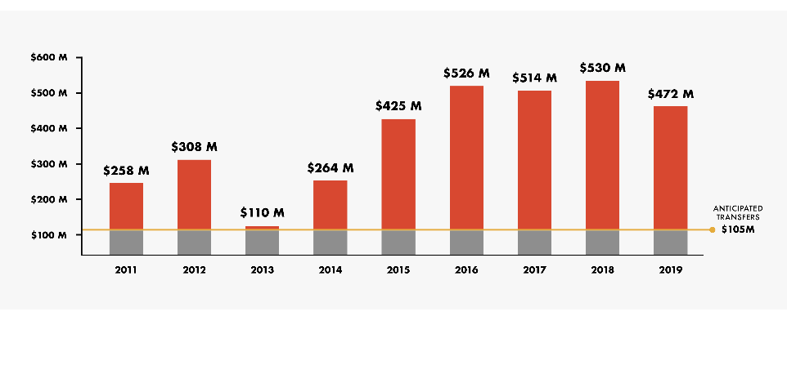
Approximately $2 billion in extraordinary transfers since 2011
Notes:
T

Slide 6
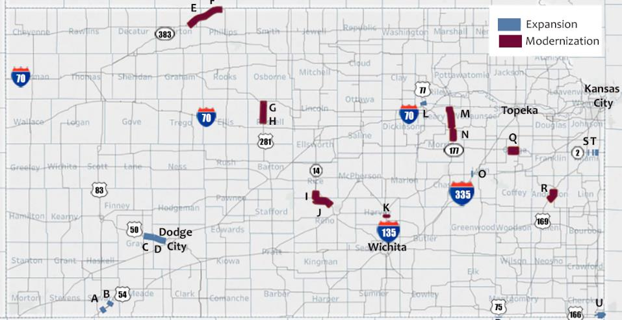
T-WORKS projects were delayed
Notes:
Those goals didn’t happen because of transfers.

Slide 7
Highway system health has declined
Gain Service Life
Lose Service Life

Slide 8
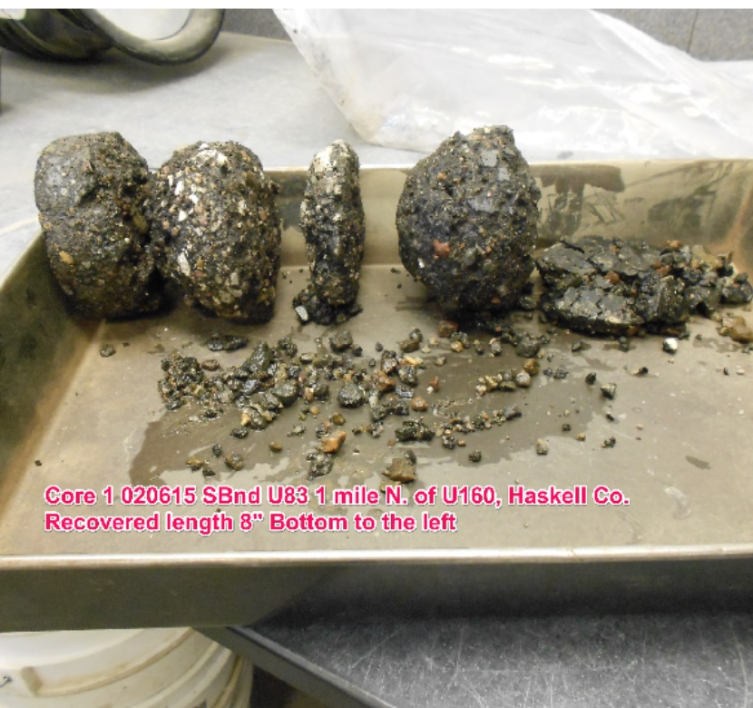
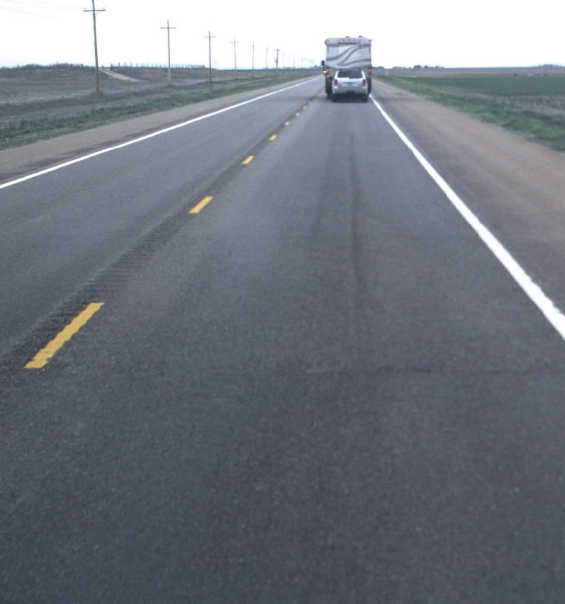
Pavement can be smooth on top, but crumbling below

Slide 9
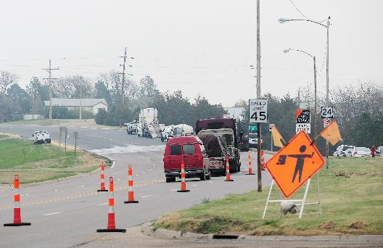
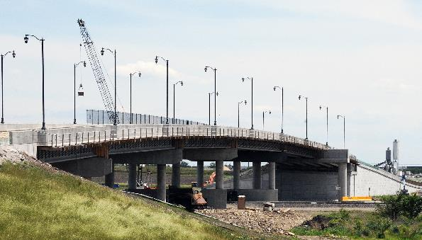
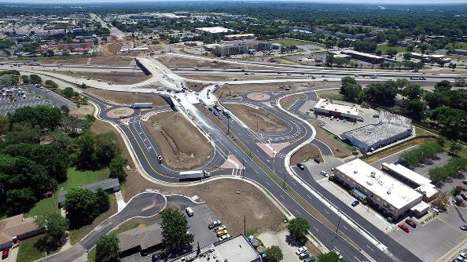
System health is improved 3 ways
Pavement Preservation work
Bridge Repair and Replacement
Modernization and
Expansion work

Slide 10
Projected preservation investment vs. actual investment
Millions

Slide 11
Avg. annual miles of pavement treatments by program

Slide 12
Funding dictates pavement treatment types
Miles of preservation work

Slide 13
Avg. annual mod./expansion investments dropped significantly
$0
CTP
Early T-WORKS
2011-2015
Late T-WORKS
2015-2017
2018
Notes:
We’re only planning to do US-69

Slide 14
Without bonding, preservation levels would have declined more
Gov & Legislature Rec. Preservation
Gov & Legislature Rec. Mod./Expansion
Bonding $242
Bonding $200
$103
Millions

Slide 15

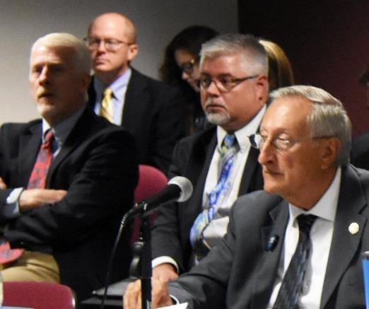
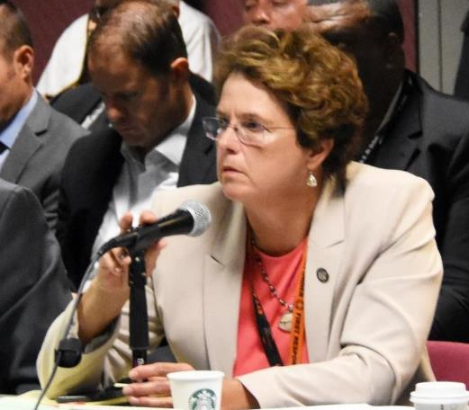
Legislative task force called for course correction

Slide 16

Governor & Legislature approved additional $216 million
 | Increase preservation from $350 to $400 M | $50 M
 | Advance 5 delayed T-WORKS projects | $86 M
 | Reinstate Local Bridge Improvement Program | $5 M
 | Implement new Cost-Share Program | $10-15 M
 | Enhance Safety Program | $5-10 M
 | Increase CCL Maintenance Payments | $2 M
 | Increase Transit, Aviation, Rail, Bike/Ped | $2 M
 |  | $166 M
 | KDOT will provide State match for Turner Diagonal project, BUILD projects | $7-12 M
 | City Connecting Link Improvement Program | $5 M
 | *Cost-Share Program for State/Local Partnerships | $3-38 M
$50M
 | TOTAL | $216 M
One-Time Allocation of
$50M, 25% match required.
Application program

Slide 17
State Highway Fund: Looking Forward
Motor Fuels Tax: Consumption growing at less than 1%.
Sales Taxes: 1.90% average annual growth for FY 2020-22.
Registration Fees, Licenses & Permits: No annual growth rate for FY 2019-22.
Road User Charge pilot study

Slide 18
Closing the Bank of KDOT would…
Complete the $435 Million of delayed T-WORKS projects
Improve system health – put us on the path to “steady state”
Allow us to address highway new mod./expansion needs

Slide 19
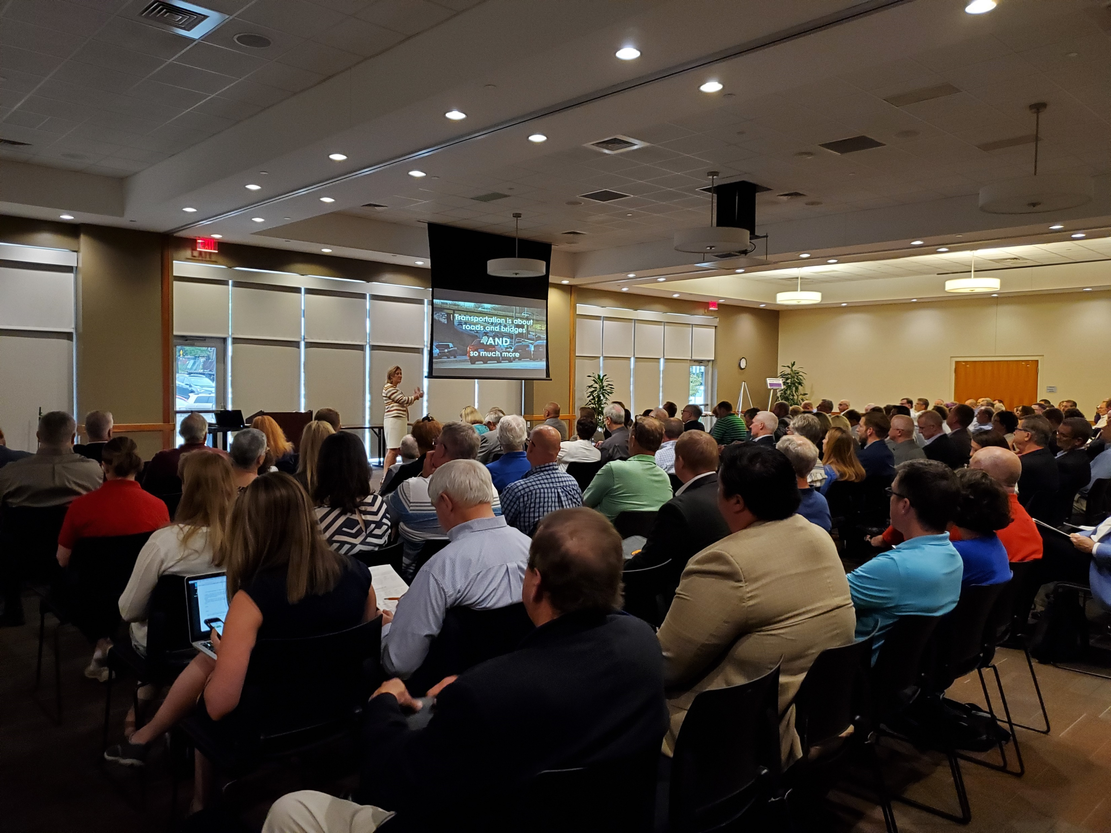
1,100 Kansans
participated

Slide 20
What we heard related to funding
Stable revenue resources are critical for providing economic opportunities and for being resilient in tough times
Playing “catch-up” is very costly in long-term
Concerns about having funding sources that rely on traditional models (MFT), which are rapidly changing
Recognition of the connection between investment in public infrastructure and private sector development
Notes:
“Our funding sources rely on traditional models, which are rapidly changing.” –
Joseph Turner, City Administrator for the City of Sedgwick
“We passionately believe in the connection between investment in public
infrastructure and what happens on the private side as a result of that.” -
Beth Linn, City Administrator for the City of Edgerton

Slide 21

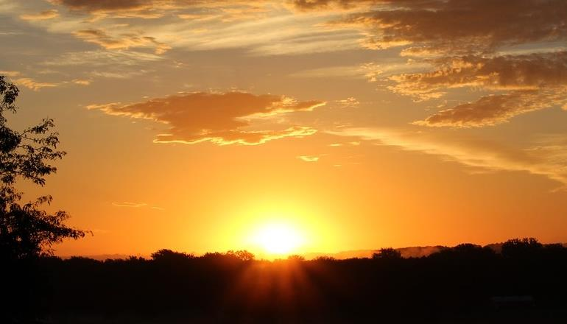

Slide 22

Improve
Health

Slide 23


Invest Strategically

Slide 24

Act Now

Slide 25

Kansas Transportation
Programs:
Start with a vision
^{Comprehensive High}
^{Program (CHP) 1990-99}
  ^{Vision: Improvement}
^{Comprehensive}
^{Transportation Program (CTP)}
²⁰⁰⁰⁻²⁰⁰⁹
  ^{Vision: Expansion}
^{T-WORKS 2011-2020}
  Vision: Preservation & Economic Dev.
^{FORWARD Kansas 2020-2029}
^{Vision: Strategic Connections}

Slide 26
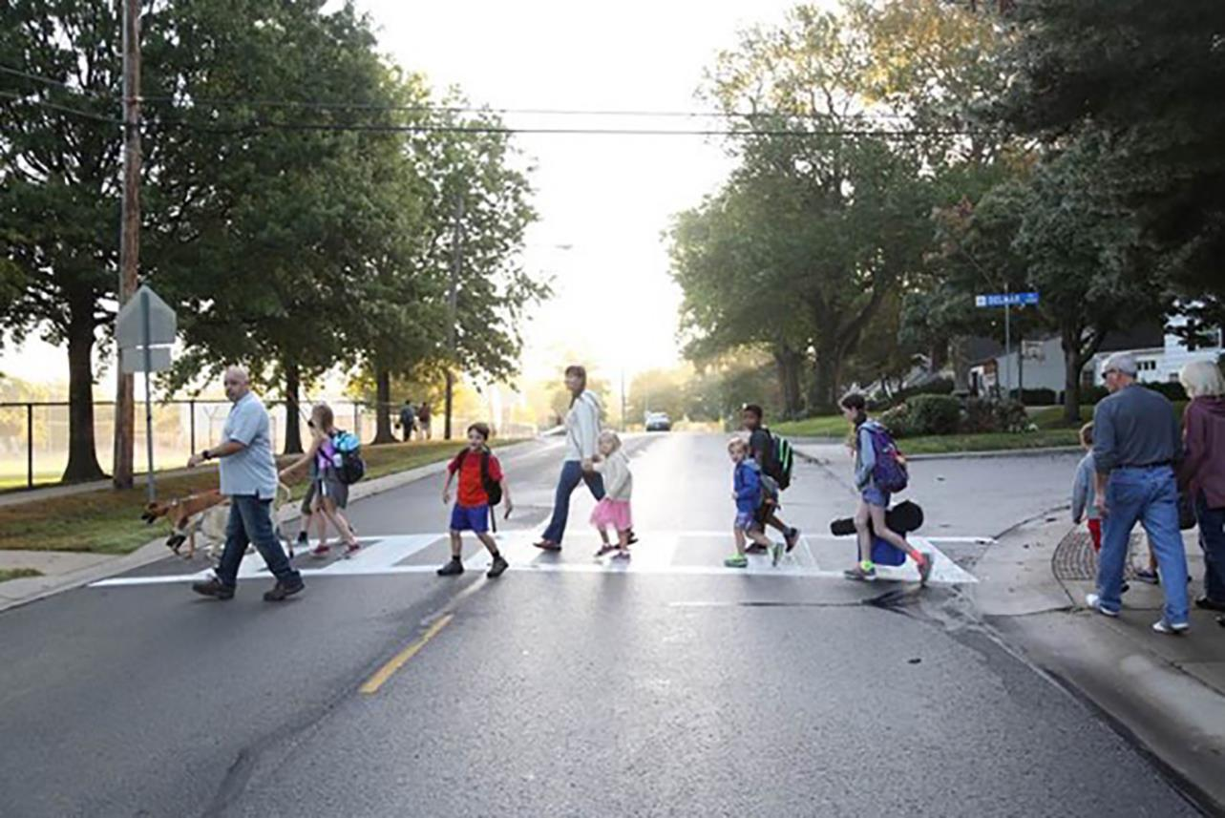

SAFER Connections

Slide 27
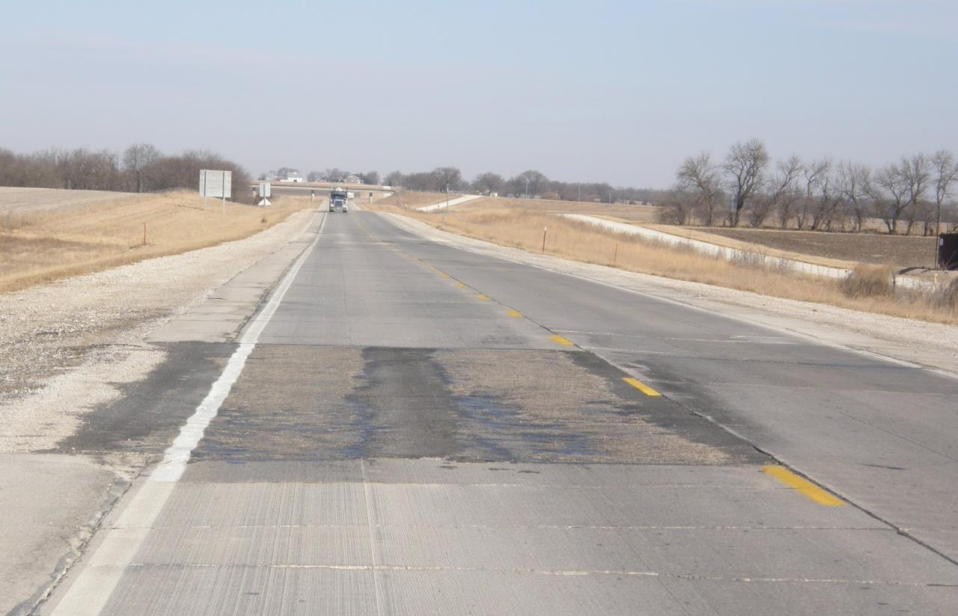
HEALTHIER Connections

Slide 28
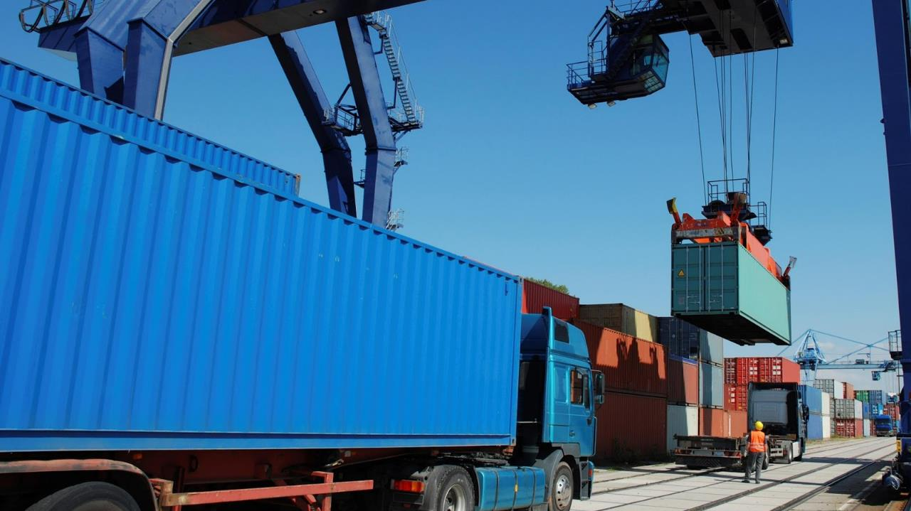
MULTIMODAL Connections

Slide 29
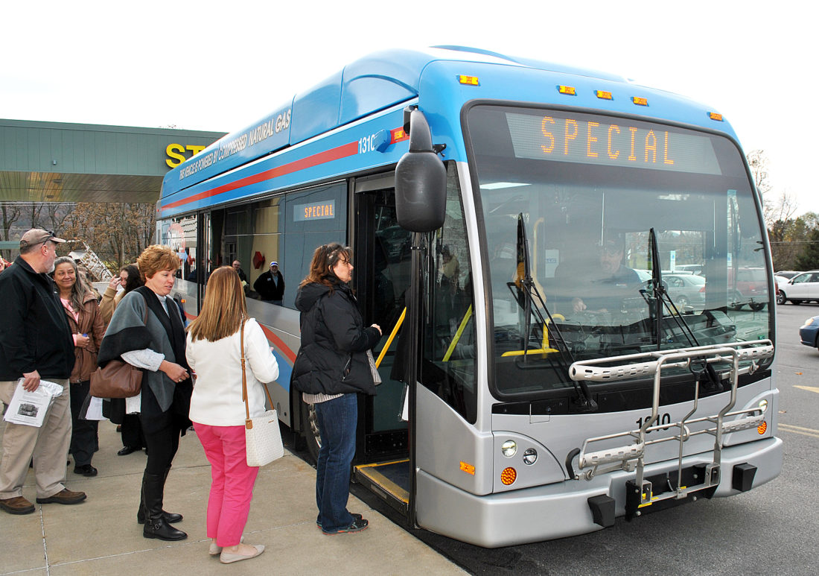
WORKFORCE & ECONOMIC Connections

Slide 30
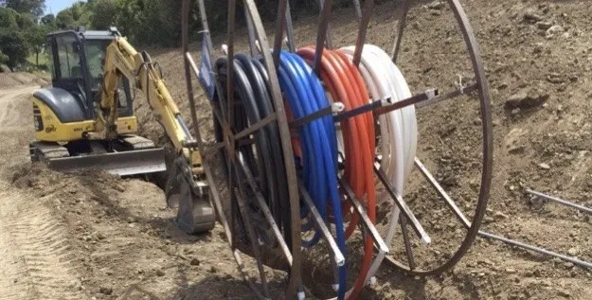
BROADBAND Connections

Slide 31
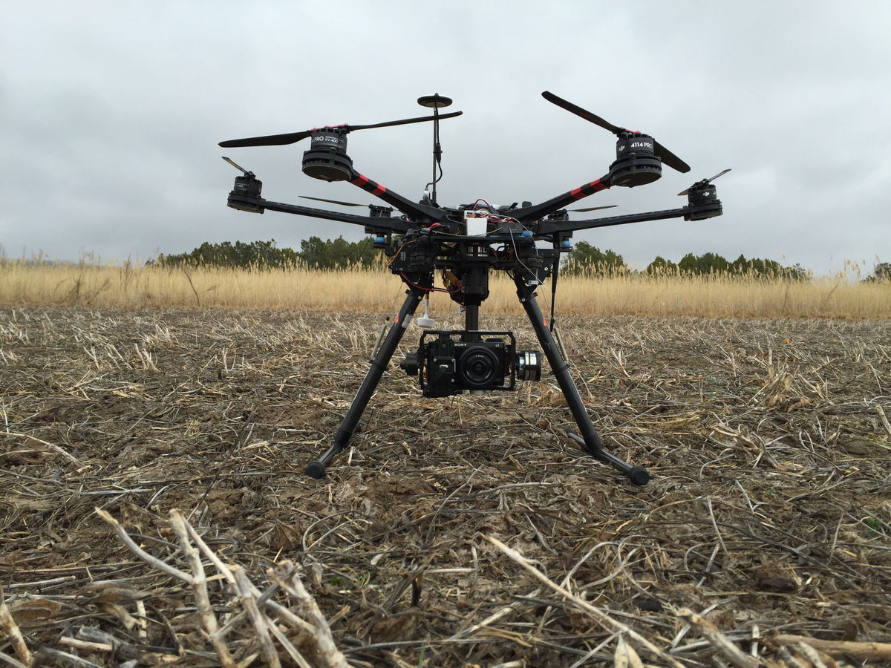
NEW Connections

Slide 32
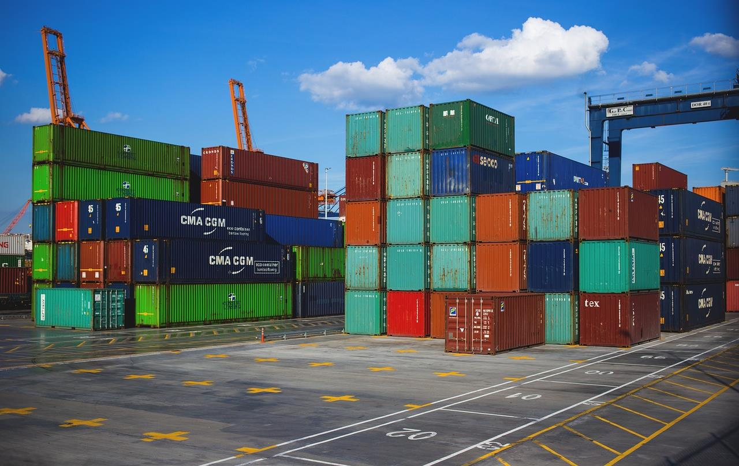
FREIGHT Connections

Slide 33
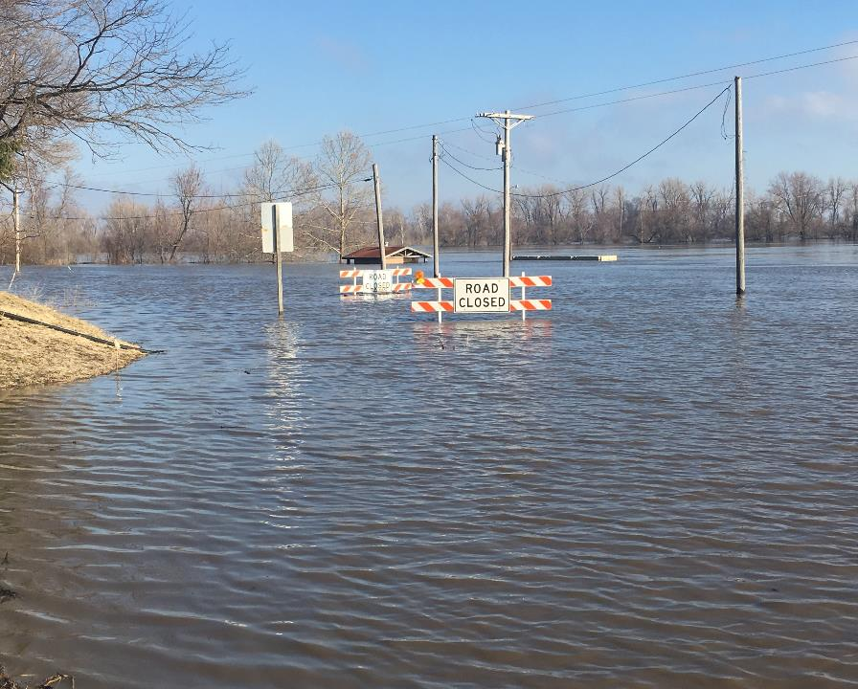
RESILIENT Connections

Slide 34
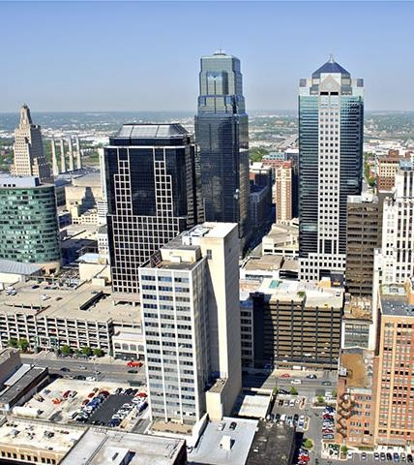
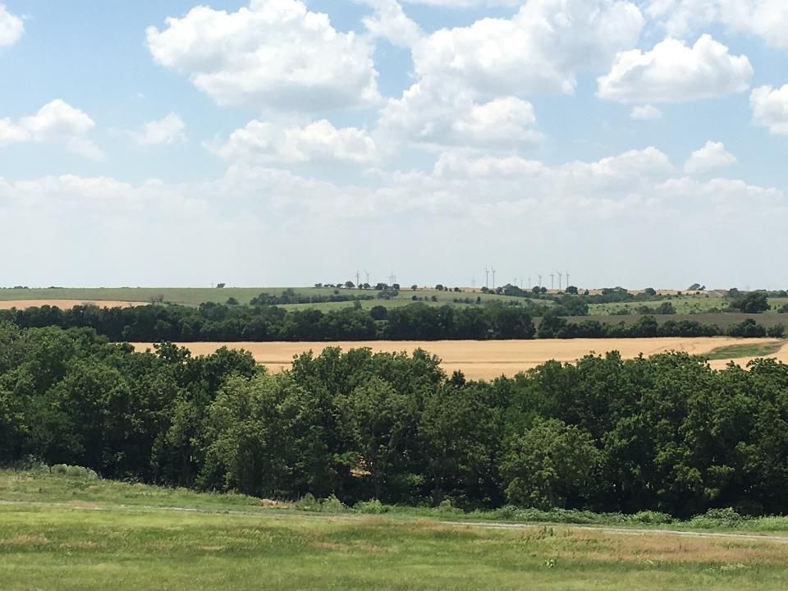
REGIONAL Connections

Slide 35
Local Consult Round 2
Oct. 29 | Southeast | Pittsburg Pittsburg State Overman Student Center | 1:30 p.m. to 4:30 p.m.
Oct. 30 | North Central | Junction City Geary County Convention Center | 1:30 p.m. to 4:30 p.m.
Nov. 5 | Northeast | Topeka Capital Plaza Hotel | 1:30 p.m. to 4:30 p.m.
Nov. 6 | Kansas City Metro | Kansas City The Reardon Convention Center | 9:00 a.m. to 12:00 p.m.
Nov. 15 | Wichita Metro | Wichita Century II Performing Arts & Convention Center | 9:00 a.m. to 12:00 p.m.
Nov. 18 | South Central | Great Bend Great Bend Events Center | 1:30 p.m. to 4:30 p.m.
Nov. 19 | Southwest | Liberal Seward County Community College | 1:30 p.m. to 4:30 p.m.
Nov. 20 | Northwest | Colby City Limits Convention Center | 1:30 p.m. to 4:30 p.m.

